Slide 1
Part I: Soteriology in Christian Theology

Slide 2
DON’T FORGET TO PUSH THE RECORD BUTTON
Part I: Soteriology in Christian Theology

Slide 3
Putting Soteriology in its Place
Soteriology and Christian Theology
Soteriology and Worldview
Defining “Save”
Biblical Words
Contextual Grammar
Three Tenses of Salvation
Justification
Sanctification
Glorification
Part I

Slide 4
Putting Soteriology in its Place
Soteriology and Christian Theology
Soteriology and Worldview
Defining “Save”
Biblical Words
Contextual Grammar
Three Tenses of Salvation
Justification
Sanctification
Glorification
Part I

Slide 5
Systematic Theology
Bibliology
Theology Proper
Christology
Pneumatology
Angelology
Anthropology
Hamartiology
Soteriology
Israelology
Ecclesiology
Eschatology

Slide 6
Systematic Theology
Bibliology — Doctrine of The Bible
Theology Proper — Doctrine of God the Father
Christology — Doctrine of God the Son
Pneumatology — Doctrine of God the Holy Spirit
Angelology — Doctrine of Angels
Anthropology — Doctrine of Man
Hamartiology — Doctrine of Sin
Soteriology — Doctrine of Salvation
Israelology — Doctrine of Israel
Ecclesiology — Doctrine of The Church
Eschatology — Doctrine of The Future

Slide 7
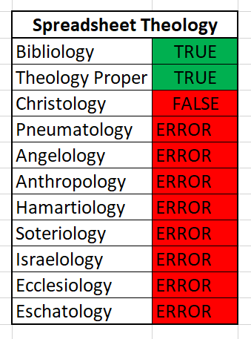
We must remember that a “system” of theology must have not only consistency, it must also have coherence. Everything must hang together. Perhaps in our high tech world another way to describe “Systematic” Theology is “Spread Sheet” Theology. When one changes one item in a spread sheet, all the other items change as well. Coherence requires it.
–David Anderson
https://faithalone.org/journal/2000ii/Anderson_Regeneration.pdf

Slide 8
Historical Theology
Dogmatic Theology
Systematic Theology
Biblical Theology

Slide 9
Historical Theology
Logical Priorities
Dogmatic Theology
Systematic Theology
Biblical Theology

Slide 10
Historical Theology
Unfortunate Tendency
Dogmatic Theology
Systematic Theology
Biblical Theology

Slide 11
Historical Theology
Bibliology
Theology Proper
Christology
Pneumatology
Angelology
Anthropology
Hamartiology
Soteriology
Israelology
Ecclesiology
Eschatology
Dogmatic Theology
Systematic Theology
Biblical Theology

Slide 12
Historical Theology
Bibliology
Theology Proper
Christology
Pneumatology
Angelology
Anthropology
Hamartiology
Soteriology
Israelology
Ecclesiology
Eschatology
Dogmatic Theology
Biblical Theology

Slide 13
Putting Soteriology in its Place
Soteriology and Christian Theology
Soteriology and Worldview
Defining “Save”
Biblical Words
Contextual Grammar
Three Tenses of Salvation
Justification
Sanctification
Glorification
Part I

Slide 14
Politics
Ethics
Epistemology
Metaphysics

Slide 15
Politics
The way things ought to be
Ethics
Epistemology
The way things are
Metaphysics

Slide 16
Politics
Logical Procession
Ethics
Epistemology
Metaphysics

Slide 17
Politics
Social Pressure
Ethics
Epistemology
Metaphysics

Slide 18
Metaphysics
Ontology
Axiology
Teleology
Eschatology
Ontology Nature of Existence
Axiology Nature of Value
Teleology Nature of Design
Eschatology Nature of the Future

Slide 19
Politics
Ethics
Bibliology
Theology Proper
Christology
Pneumatology
Angelology
Anthropology
Hamartiology
Soteriology
Israelology
Ecclesiology
Eschatology
Epistemology
Ontology
Axiology
Teleology
Eschatology

Slide 20
Free Grace Soteriology: Great and Small
Great because:
Small because:
Determines a person’s eternal destination
Forms a person’s view of God in fundamental ways
Establishes a basic framework for Christian living
Does not suffice for a holistic theology and worldview
Leaves room for erroneous views of God
Does not exhaust the richness of Christian living

Slide 21
Putting Soteriology in its Place
Soteriology and Christian Theology
Soteriology and Worldview
Defining “Save”
Biblical Words
Contextual Grammar
Three Tenses of Salvation
Justification
Sanctification
Glorification
Part I

Slide 22
The Hebrew Words for “Save”
ישׁע(yâsha‛)
נצל (nâtsal)
207 x
Never used in reference to individual salvation from damnation
213 x
Never used in reference to individual salvation from damnation

Slide 23
[יָשַׁע] vb. Hiph. deliver; Niph. intrans. and pass. — Niph. 1. be liberated, saved (prop. placed in freedom), from external evils, by God; with מִן. 2. be saved in battle, victorious. Hiph. 1. deliver, save (prop. give width and breadth to, liberate), in peril, c. acc. pers. vel loc.; with לְ pers. (with acc.); abs. Specif. save, from evils and troubles: a. of heroic men, saving the nation in war; these are named מוֹשִׁיעַ saviour; they save מִיַּד from the hand of. b. of God, who saves his people from extended evils; or the pious among them; the king; David; thy servant; accordingly God is מוֹשִׁיעַ saviour; that fr. wh. one is saved constr. c. מִן. c. there is no other salvation, the sword saves not, or a nation, or astrologers, or Asshur, or other gods. 2. save from moral troubles. 3. give victory to: a. of man, c. לְ pers., give victory to, c. agent subj. יַד, יַד om. b. of God, with לְ pers.; Yahweh, with acc.; abs. gain victory.
יֵשַׁע n.m. deliverance, rescue, salvation, also safety, welfare — 1. safety, welfare, prosperity. 2. salvation, i.e. primarily physical rescue, by God, oft. with added spiritual idea; יֵשַׁע אֱלֹהִים salvation from God; used as infin. with acc. לְיֵשַׁע; accordingly Yahweh is אוֹרִי וְיִשְׁעִי my light and my salvation. 3. victory.
יְשׁוּעָה n.f. salvation — 1. welfare, prosperity. 2. deliverance. 3. salvation by God, primarily from external evils, but often with added spiritual idea; with verbs of rejoicing; pl. יְשׁוּעוֹת (intensive), of ˊי. 4. victory: c. עָשָׂה work victory; elsewhere of victories wrought by Yahweh for his people. Cf. the syn.
יְהוֹשׁוּעַ, יהוֹשֻׁעַ, and (later) יֵשׁוּעַ n.pr.m. (& loc., v. 9 infr.) (ˊי is salvation, or ˊי is oppulence, cf. אֱלִישָׁע, אֱלִישׁוּעַ, אֲבִישׁוּעַ; in any case it came to be associated with ישׁע) — 1. Moses’ successor, son of Nun. 2. יְהוֹשֻׁעַ a Bethshemite. 3. h.p. after the restoration, son of Jehozadak. 4. יְהוֹשֻׁעַ governor of Jerusalem under Josiah. 5. יֵשׁוּעַ head of one of the classes of priests. 6. יֵשׁוּעַ a Levitical family-name of freguent occurrence: a. b. 7. יֵשׁוּעַ, father of a builder at the wall, perh. = 8. a Judaite family name. 9. n. pr.loc. in south of Judah.
Richard Whitaker et al., The Abridged Brown-Driver-Briggs Hebrew-English Lexicon of the Old Testament: From A Hebrew and English Lexicon of the Old Testament by Francis Brown, S.R. Driver and Charles Briggs, Based on the Lexicon of Wilhelm Gesenius (Boston; New York: Houghton, Mifflin and Company, 1906).

Slide 24
[נָצַל] vb. not in Qal; Pi. strip, plunder; Niph. deliver oneself, be delivered; Hiph. snatch away, deliver — Niph. 1. reflex. tear oneself away, deliver oneself: abs.; c. מִיַּד; אֶל … מֵעִם escape from — unto. 2. passive, be torn out or away מִפִּי הָאֲרִי; be delivered, abs.; מִפְּנֵי; מִכַּף; מִן. Pi. 1. strip off, spoil, abs.; c. acc. pers. 2. deliver, c. acc. נַפְשָׁם. Hiph. 1. take away, snatch away, e.g. property, prey from the mouth of animals, words of ˊי from the mouth; וְאֵין מַצִּיל בֵּינֵיהֶם and there was none to tear them apart (two fighting); וְהִצִּיל עֵינֵנוּ and take away our eye (elude our sight). 2. rescue, recover, e.g. cities; wives and property. 3. deliver from: a. enemies and troubles, abs.; אֵין מַצִּיל; c. acc.; הַצִּיל נַפְשׁוֹ; c. מִן from; מִיַּד from the hand or power of; מִתַּחַת יַד; מִכַּף. b. from death; מִמּוֹת; מִשְּׁאוֹל. 4. deliver from sin and guilt (in late writings), מִכָּל־פְּשָׁעַי from all my transgressions; מִדָּמִים from bloodguiltiness; הַצִּילֵנוּ וְכַפֵּר עַל־חַטֹּאתֵינוּ deliver us and cover over all our sins. Hoph. plucked out. Hithp. stripped themselves.
הַצָּלָה n.f. deliverance.
Richard Whitaker et al., The Abridged Brown-Driver-Briggs Hebrew-English Lexicon of the Old Testament: From A Hebrew and English Lexicon of the Old Testament by Francis Brown, S.R. Driver and Charles Briggs, Based on the Lexicon of Wilhelm Gesenius (Boston; New York: Houghton, Mifflin and Company, 1906).

Slide 25
Aramaic, Akkadian, blah blah blah
שְׁתַר , Ithpa. אִשְׁתַּתַּר, אִשְׁתַּר (v. שׁוֹתַר) to be left over; to escape. Targ. Job XXI, 16. Ib. 34. Ib. XIX, 20.—Lev. R. s. 13 אף אתון לא אִשְׁתָּרִיתון are you not of those that survived?
שׁזב to save, rescue. [BAram. שֵׁיזִב, שֵׁיזְיב, JAram. שֵׁיזֵב, Nab. שׁ(י)זב, Syr. שׁוֹזֵב (= he saved, rescued). All these words are borrowed from Akka. shūzubu, ushēzib, part. mushēzib (= ‘to save, rescue’, prob. ‘to leave over’), Shaph. of ezēbu (= to leave over, leave), which is related to Heb. עָזַב. See עזב ᴵ.]
Jastrow Dictionary here: www.sefaria.org/Jastrow%2C_שַׂתָּת
Klein Dictionary here: www.sefaria.org/Klein_Dictionary%2C_שׁזב.1

Slide 26
The Greek Word for “Save”
σώζω (sōzō)
ῥύομαι (rhuomai)
120 x in NT
343 x in LXX
Minority of usage refers to individual salvation from damnation
18 x in NT
193 x in OT LXX
“Deliver(er/ed)” in KJV
Has connotation of “transfer”
1 usage for individual salvation from damnation (Col. 1:13) (?)
Often ignored in soteriology

Slide 27
Greek Words Related to “Sōzō”
σωτηρία (sōtēria)
σωτήρ (sōtēr)
44 x NT
162 x OT LXX
“Salvation”
Usually not used in reference to salvation of individuals from damnation
24 x NT
38 x OT LXX
“Saviour”
In NT usually a reference to Jesus (sometimes “God,” not specific)
Individual salvation from damnation is not Jesus’ only salvific ministry

Slide 28
Sōzō in the LXX
Hebrew:
ישׁע—to help, save; to receive, accept help; to be victorious (141): …
מלט 1—to flee to safety; to save someone; to save oneself; to leave undisturbed, at rest (43): …
נצל—to pull out, save; to be saved, be secure; to save oneself; to tear from; to remove, withdraw (20): …
מוֹשִׁיעַ—deliverer, savior (10): …
פְּלֵיטָה—survivor, survival; someone or something remaining; escape, deliverance (5): …
חיה—to be alive, to stay alive; to live; to revive, recover, return to life (5): …
שָׂרִיד 1—someone fleeing (5): …
עזר 1—to help, assist; to come to help (5): …
פָּלִיט—survivor; fugitive (4): …
פדה—to buy out; to redeem; to be ransomed, be released (2): …
Aramaic:
יזב—to rescue (2): …
The Lexham Analytical Lexicon of the Septuagint (Bellingham, WA: Lexham Press, 2012).

Slide 29
Putting Soteriology in its Place
Soteriology and Christian Theology
Soteriology and Worldview
Defining “Save”
Biblical Words
Contextual Grammar
Three Tenses of Salvation
Justification
Sanctification
Glorification
Part I

Slide 30
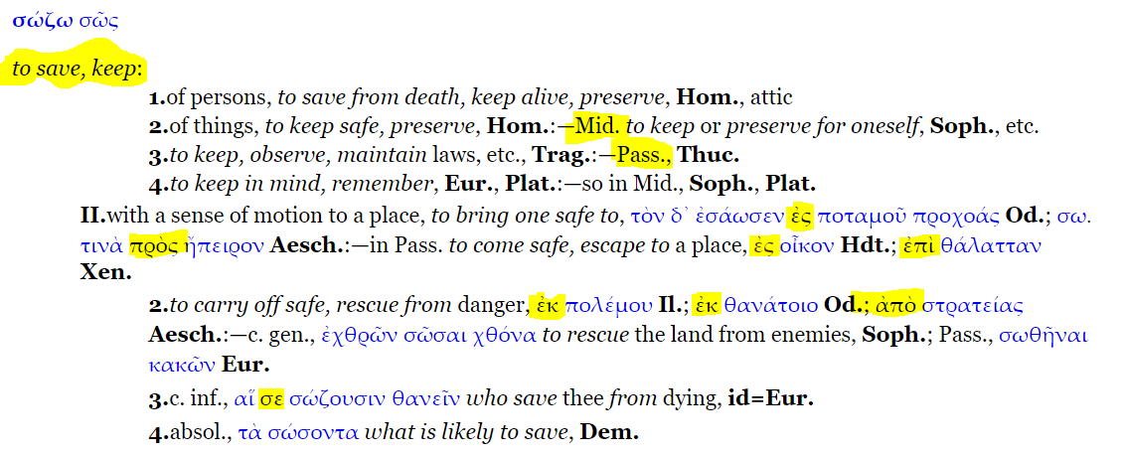
Sōzō Grammatical Considerations
From Middle Liddle here: http://www.perseus.tufts.edu/hopper/morph?l=seswsme%2Fnoi&la=greek&can=seswsme%2Fnoi1&prior=e)ste#Perseus:text:1999.04.0058:entry=sw/zw-contents

Slide 31
Context Questions
Who saves whom?
From what?
To what?
How?
When?

Slide 32
Context Questions
Who saves whom?
From what?
To what?
How?
When?
²⁰ And suddenly, a woman who had a flow of blood for twelve years came from behind and touched the hem of His garment. ²¹ For she said to herself, “If only I may touch His garment, I shall be made well [σωθήσομαι^{V-FPI-1S}].”
(Matt. 9:20–21 NKJV)

Slide 33
Context Questions
Who saves whom?
From what?
To what?
How?
When?
¹¹ After saying these things, he said to them, “Our friend Lazarus has fallen asleep, but I go to awaken him.” ¹² The disciples said to him, “Lord, if he has fallen asleep, he will recover [σωθήσεται^{V-FPI-3S}].” ¹³ Now Jesus had spoken of his death, but they thought that he meant taking rest in sleep.
(John 11:11–13 ESV)

Slide 34
Context Questions
Who saves whom?
From what?
To what?
How?
When?
²³ And when he got into the boat, his disciples followed him. ²⁴ And behold, there arose a great storm on the sea, so that the boat was being swamped by the waves; but he was asleep. ²⁵ And they went and woke him, saying, “Save us [σῶσον^{V-AAM-2S}], Lord; we are perishing.”
(Matt. 8:23–25 ESV)

Slide 35
Context Questions
Who saves whom?
From what?
To what?
How?
When?
And she shall bring forth a son; and thou shalt call his name JESUS; for it is he that shall save [σώσει^{V-FAI-3S}] his people from their sins.
(Matt 1:21 ASV)

Slide 36
Context Questions
Who saves whom?
From what?
To what?
How?
When?
And the Lord shall deliver [ῥύσεταί^{V-FDI-3S}] me from every evil work, and will preserve [σώσει^{V-FAI-3S}] me unto his heavenly kingdom: to whom be glory for ever and ever. Amen.
(2 Tim. 4:18 KJV)

Slide 37
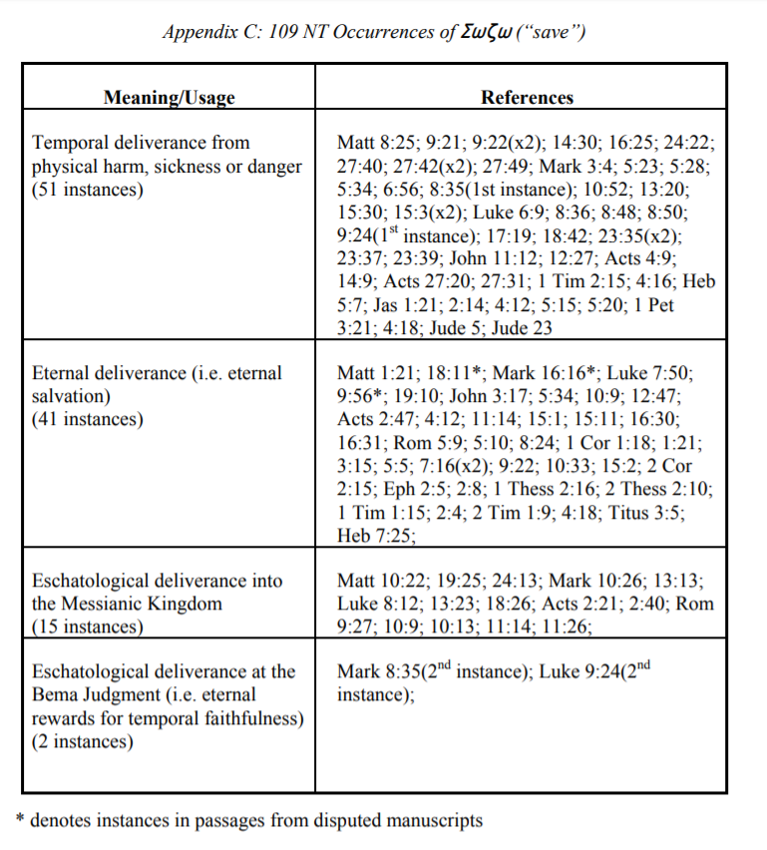
Chart by J. B. Hixon. Available at http://www.notbyworks.org/

Slide 38
Putting Soteriology in its Place
Soteriology and Christian Theology
Soteriology and Worldview
Defining “Save”
Biblical Words
Contextual Grammar
Three Tenses of Salvation
Justification
Sanctification
Glorification
Part I

Slide 39
Three Phases of Individual Salvation
 | Justification | Sanctification | Glorification
From: | Penalty of Sin | Power of Sin | Presence of Sin
When: | Past | Present | Future
How: | Through faith alone in Christ alone | Through daily dependence on HS | Death or Rapture
Sample Texts: | Eph. 2:8–9; Titus 3:5 | Phil. 2:12; Jas. 1:21 | Rom. 13:11; 1 Thess. 5:8–9

Slide 40
Justification
From the penalty of sin
In the past (at first moment of faith)
Through faith alone in Christ alone

Slide 41
Justification
From the penalty of sin
In the past (at first moment of faith)
Through faith alone in Christ alone
⁸ For by grace you have been saved through faith, and that not of yourselves; it is the gift of God, ⁹ not of works, lest anyone should boast.
⁵ not by works of righteousness which we have done, but according to His mercy He saved us, through the washing of regeneration and renewing of the Holy Spirit,
(Eph. 2:8–9; Titus. 3:5 NKJV)

Slide 42
Sanctification
From the power of sin
In the present
Through daily dependence on the Holy Spirit

Slide 43
Sanctification
From the power of sin
In the present
Through daily dependence on the Holy Spirit
¹² Therefore, my beloved, as you have always obeyed, not as in my presence only, but now much more in my absence, work out your own salvation with fear and trembling;
²¹ Therefore lay aside all filthiness and overflow of wickedness, and receive with meekness the implanted word, which is able to save your souls.
(Phil. 2:12; Jas. 1:21 NKJV)

Slide 44
Glorification
From the presence of sin
In the future
Through physical death or rapture

Slide 45
Glorification
From the presence of sin
In the future
Through physical death or rapture
¹¹ And do this, knowing the time, that now it is high time to awake out of sleep; for now our salvation is nearer than when we first believed.
⁸ But let us who are of the day be sober, putting on the breastplate of faith and love, and as a helmet the hope of salvation. ⁹ For God did not appoint us to wrath, but to obtain salvation through our Lord Jesus Christ,
(Rom. 13:11; 1 Thess. 5:8–9 NKJV)

Slide 46
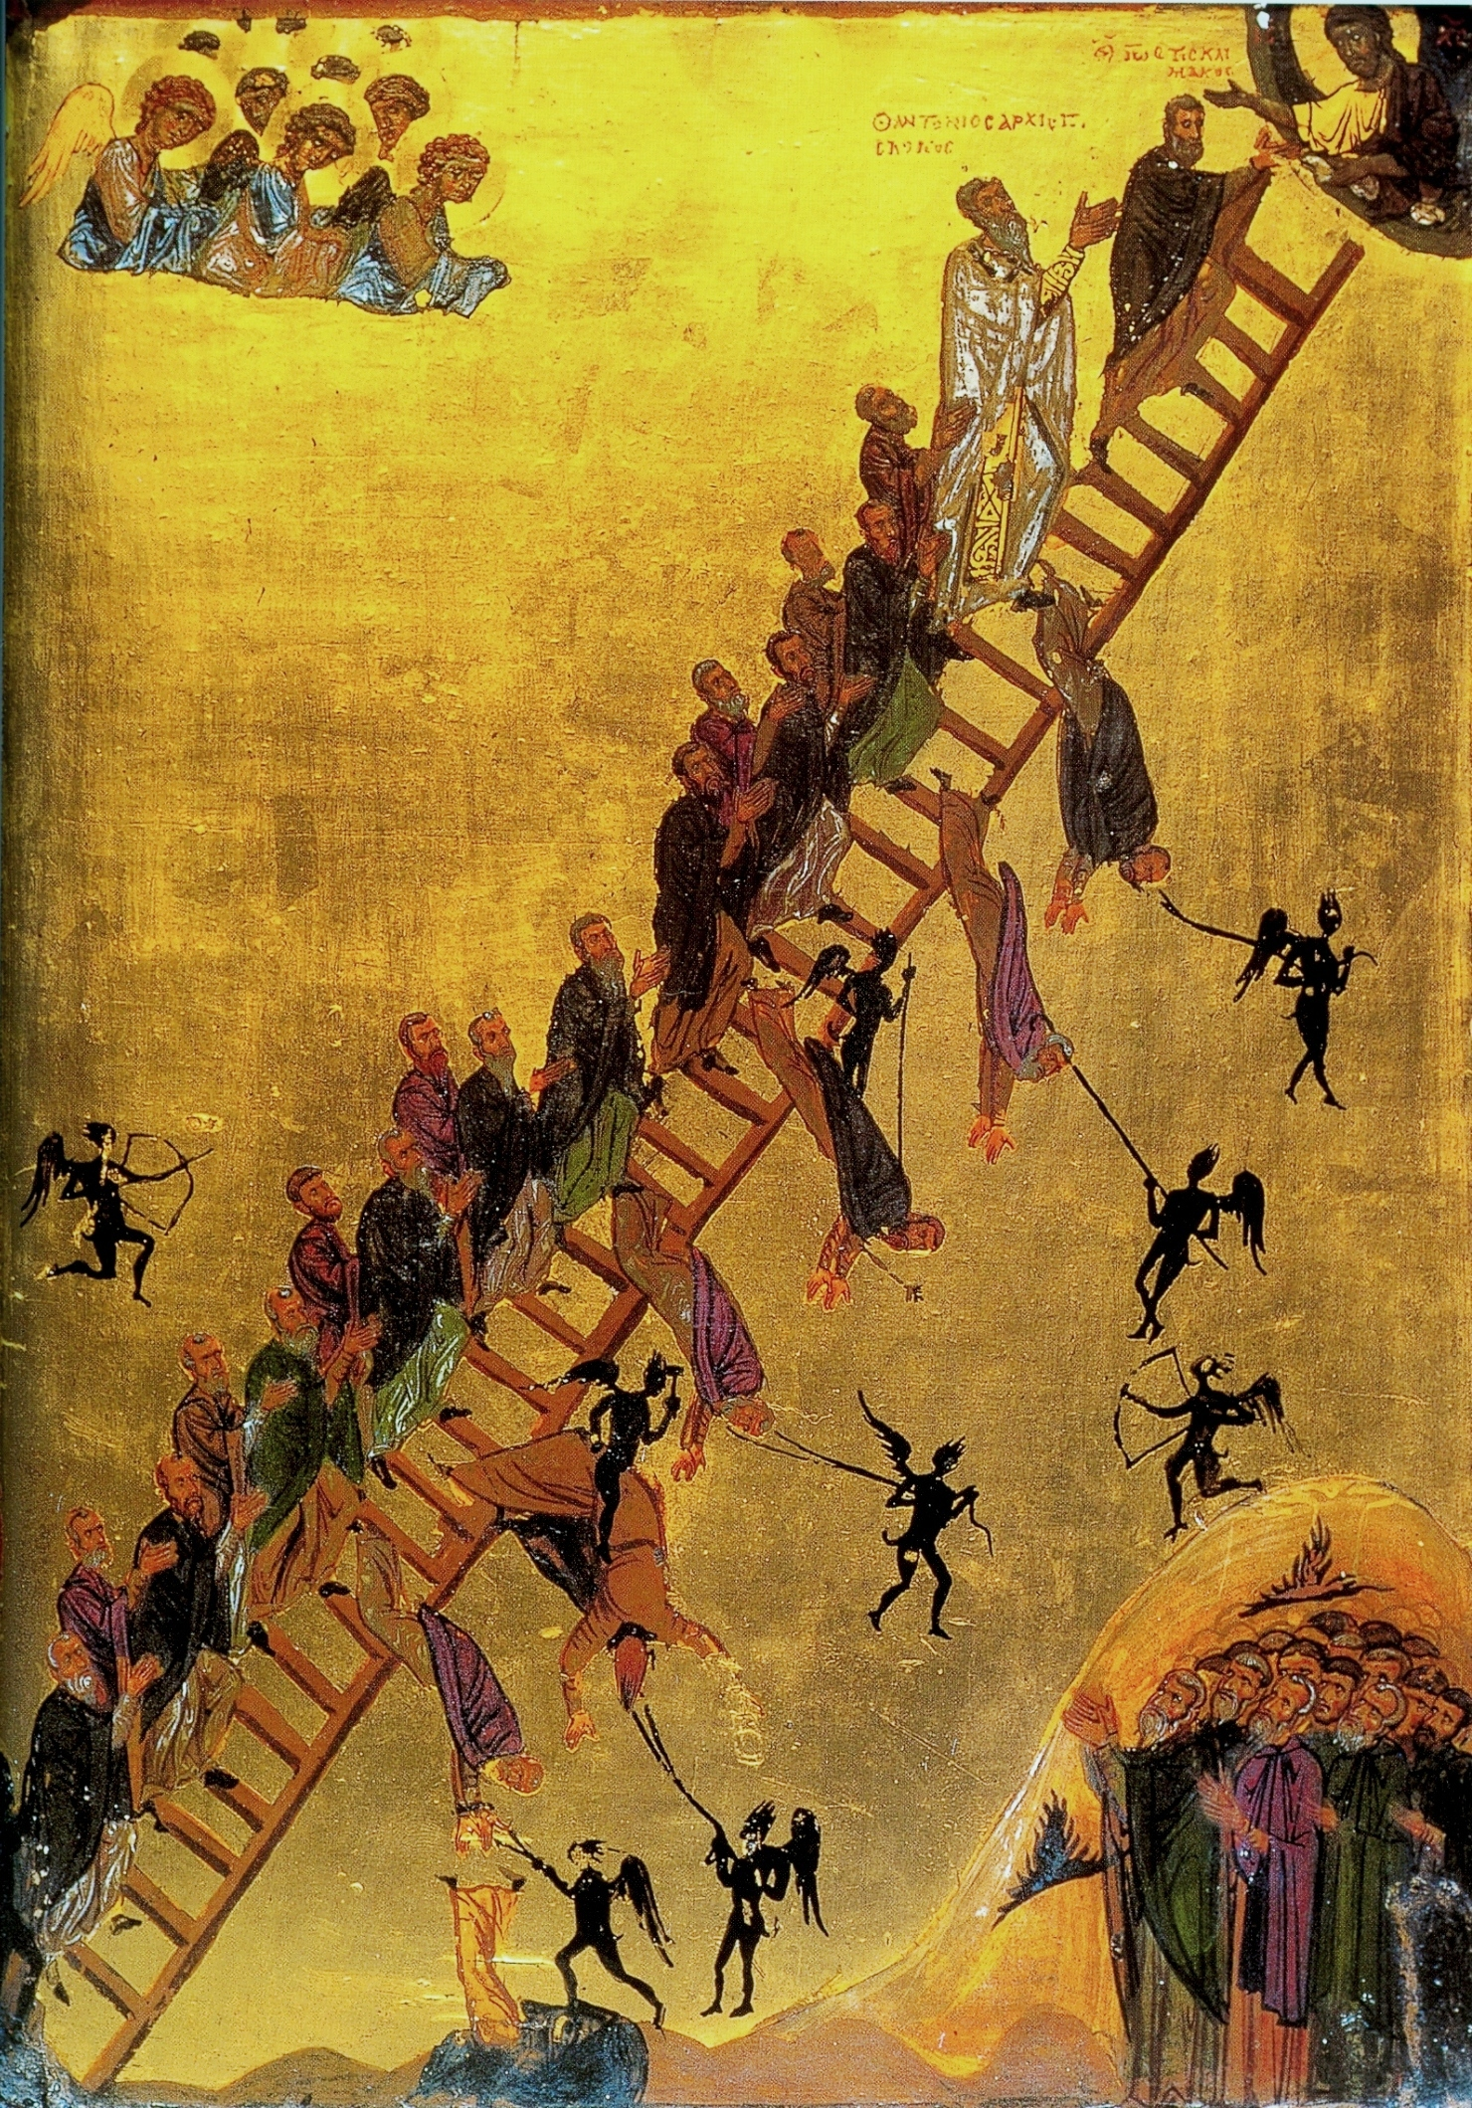
Pop Quiz!
What’s wrong with this picture?
30 Rungs by John Climacus
1–4: Renunciation of the world and obedience to a spiritual father
1. Περί αποταγής (On renunciation of the world, or asceticism)
2. Περί απροσπαθείας (On detachment)
3. Περί ξενιτείας (On exile or pilgrimage; concerning dreams that beginners have)
4. Περί υπακοής (On blessed and ever-memorable obedience (in addition to episodes involving many individuals))
5–7: Penitence and affliction (πένθος) as paths to true joy
5. Περί μετανοίας (On painstaking and true repentance, which constitutes the life of the holy convicts, and about the Prison)
6. Περί μνήμης θανάτου (On remembrance of death)
7. Περί του χαροποιού πένθους (On joy-making mourning)
8–17: Defeat of vices and acquisition of virtue
8. Περί αοργησίας (On freedom from anger and on meekness)
9. Περί μνησικακίας (On remembrance of wrongs)
10. Περί καταλαλιάς (On slander or calumny)
11. Περί πολυλογίας και σιωπής (On talkativeness and silence)
12. Περί ψεύδους (On lying)
13. Περί ακηδίας (On despondency)
14. Περί γαστριμαργίας (On that clamorous mistress, the stomach)
15. Περί αγνείας (On incorruptible purity and chastity, to which the corruptible attain by toil and sweat)
16. Περί φιλαργυρίας (On love of money, or avarice)
17. Περί ακτημοσύνης (On non-possessiveness (that hastens one Heavenwards))
18–26: Avoidance of the traps of asceticism (laziness, pride, mental stagnation)
18. Περί αναισθησίας (On insensibility, that is, deadening of the soul and the death of the mind before the death of the body)
19. Περί ύπνου και προσευχής (On sleep, prayer, and psalmody with the brotherhood)
20. Περί αγρυπνίας (On bodily vigil and how to use it to attain spiritual vigil, and how to practice it)
21. Περί δειλίας (On unmanly and puerile cowardice)
22. Περί κενοδοξίας (On the many forms of vainglory)
23. Περί υπερηφανείας, Περί λογισμών βλασφημίας (On mad pride and (in the same Step) on unclean blasphemous thoughts; concerning unmentionable blasphemous thoughts)
24. Περί πραότητος και απλότητος (On meekness, simplicity, and guilelessness, which come not from nature but from conscious effort, and on guile)
25. Περί ταπεινοφροσύνης (On the destroyer of the passions, most sublime humility, which is rooted in spiritual perception)
26. Περί διακρίσεως (On discernment of thoughts, passions and virtues; on expert discernment; brief summary of all aforementioned)
27–29: Acquisition of hesychia, or peace of the soul, of prayer, and of apatheia (dispassion or equanimity with respect to afflictions or suffering)
27. Περί ησυχίας (On holy stillness of body and soul; different aspects of stillness and how to distinguish them)
28. Περί προσευχής (On holy and blessed prayer, the mother of virtues, and on the attitude of mind and body in prayer)
29. Περί απαθείας (Concerning Heaven on earth, or Godlike dispassion and perfection, and the resurrection of the soul before the general resurrection)
30. Περί αγάπης, ελπίδος και πίστεως (Concerning the linking together of the supreme trinity among the virtues; a brief exhortation summarizing all that has said at length in this book)
Ladder of Divine Ascent
12th century Greek Orthodox icon

Slide 47
Putting Soteriology in its Place
Soteriology and Christian Theology
Soteriology and Worldview
Defining “Save”
Biblical Words
Contextual Grammar
Three Tenses of Salvation
Justification
Sanctification
Glorification
Part I

