Slide 1
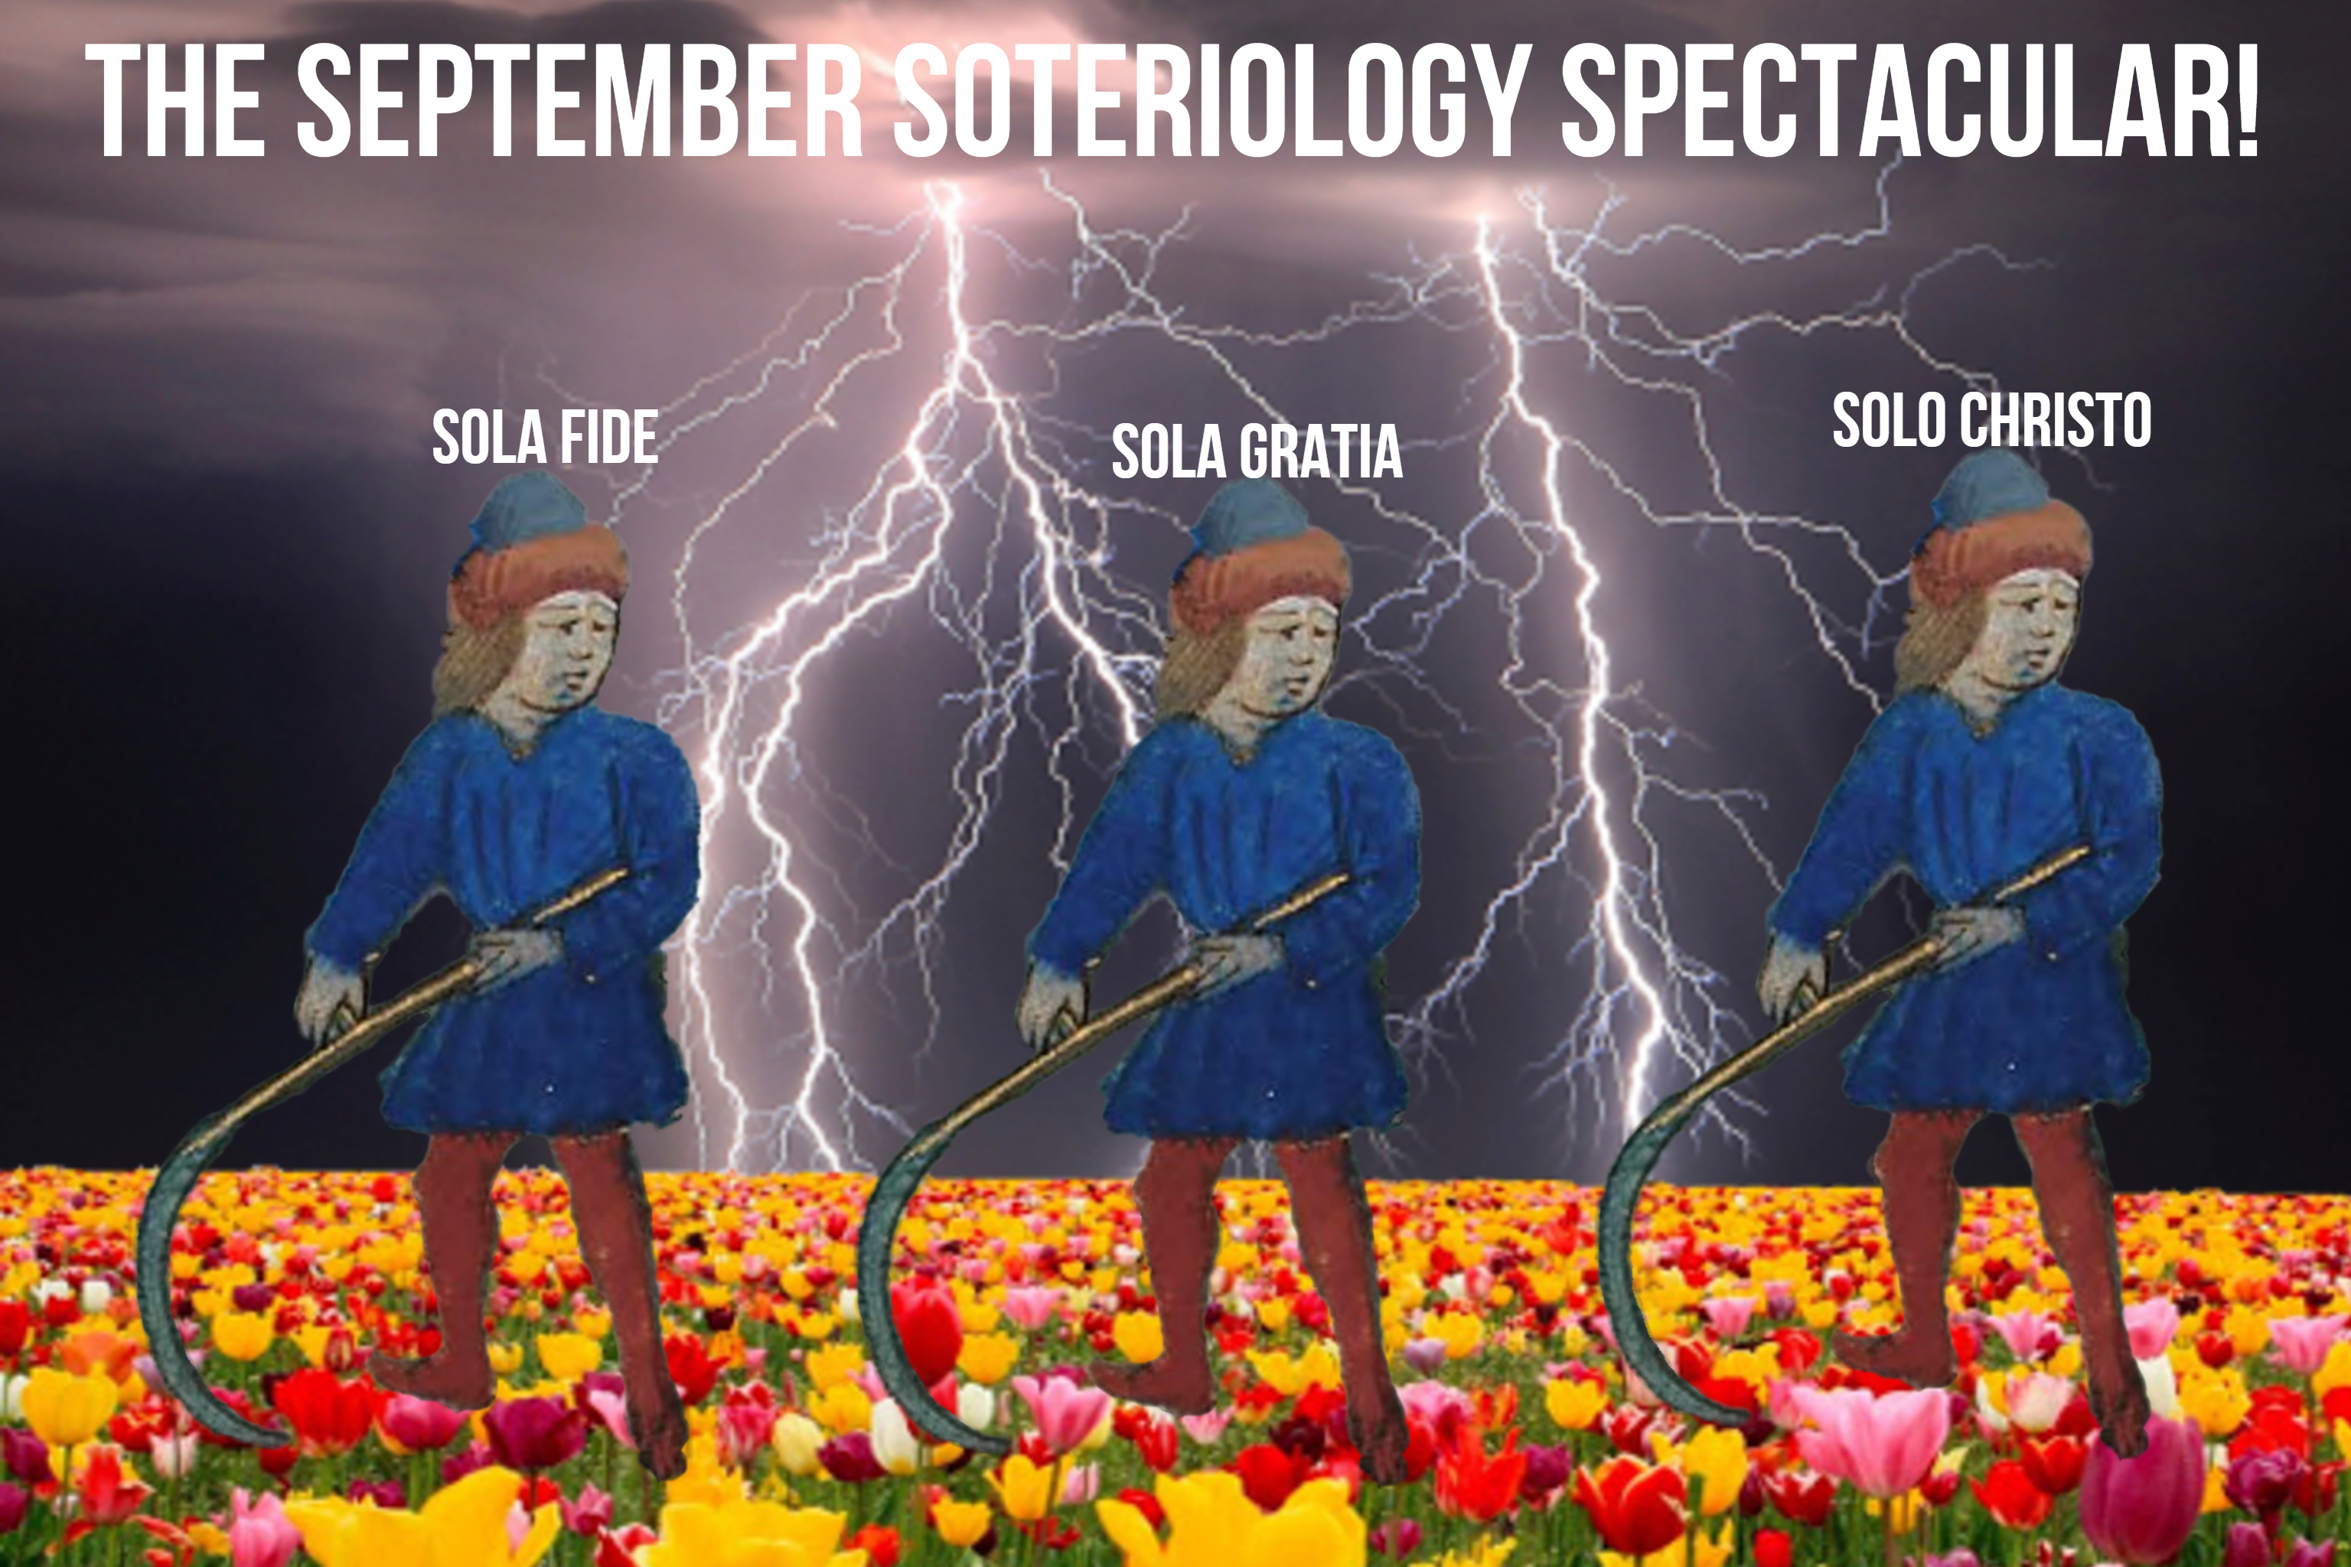
Part II: Man’s Need for Salvation

Slide 2
DON’T FORGET TO PUSH THE RECORD BUTTON
Part II: Man’s Need for Salvation

Slide 3
Review!

Slide 4
Historical Theology
Bibliology
Theology Proper
Christology
Pneumatology
Angelology
Anthropology
Hamartiology
Soteriology
Israelology
Ecclesiology
Eschatology
Dogmatic Theology
Systematic Theology
Biblical Theology

Slide 5
______ Theology
______
______
______
______
______
______
______
______
______
______
______
______ Theology
______ Theology
______ Theology

Slide 6
______ Theology
______
______
______
______
______
______
______
______
______
______
______
______ Theology
______ Theology
Biblical Theology

Slide 7
______ Theology
______
______
______
______
______
______
______
______
______
______
______
______ Theology
Systematic Theology
Biblical Theology

Slide 8
______ Theology
______
______
______
______
______
______
______
______
______
______
______
Dogmatic Theology
Systematic Theology
Biblical Theology

Slide 9
Historical Theology
______
______
______
______
______
______
______
______
______
______
______
Dogmatic Theology
Systematic Theology
Biblical Theology

Slide 10
Historical Theology
Bibliology
______
______
______
______
______
______
______
______
______
______
Dogmatic Theology
Systematic Theology
Biblical Theology

Slide 11
Historical Theology
Bibliology
Theology Proper
Christology
Pneumatology
______
______
______
______
______
______
______
Dogmatic Theology
Systematic Theology
Biblical Theology

Slide 12
Historical Theology
Bibliology
Theology Proper
Christology
Pneumatology
Angelology
______
______
______
______
______
______
Dogmatic Theology
Systematic Theology
Biblical Theology

Slide 13
Historical Theology
Bibliology
Theology Proper
Christology
Pneumatology
Angelology
Anthropology
Hamartiology
Soteriology
______
______
______
Dogmatic Theology
Systematic Theology
Biblical Theology

Slide 14
Historical Theology
Bibliology
Theology Proper
Christology
Pneumatology
Angelology
Anthropology
Hamartiology
Soteriology
Israeology
Ecclesiology
______
Dogmatic Theology
Systematic Theology
Biblical Theology

Slide 15
Historical Theology
Bibliology
Theology Proper
Christology
Pneumatology
Angelology
Anthropology
Hamartiology
Soteriology
Israeology
Ecclesiology
Eschatology
Dogmatic Theology
Systematic Theology
Biblical Theology

Slide 16
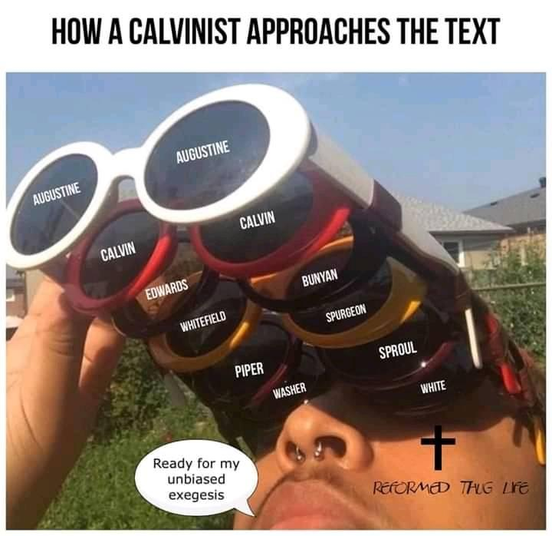

Slide 17
Three Phases of Salvation
Hints:
δικαίωμα
dikaiōma
ἁγιασμός
hagiasmos
δοξάζω
doxazō

Slide 18
God’s Holiness
God’s Holiness Described
God’s Perfect Justice
Man’s Sinfulness
Hamartiology 101
Futility of Self-Righteousness
Errant Views
Hell
Its Reality
Reason for Hell
Errant Views
Part II

Slide 19
קֹדֶשׁ n.m. apartness, sacredness (opp. חֹל) — 1. apartness, sacredness, holiness, of God: a. of divine activity, syn. majesty, בַּקֹּדֶשׁ (of victory), (song); ˊזְרוֹע ק holy arm. b. to attest his word as inviolable. c. of his name as sacred, inviolable, separate from all defilement, etc.; and so d. רוּחַ קָדְשׁוֹ his holy Spirit. 2. of places set apart as sacred by God’s presence: a. heavenly abode. b. on earth: c. the tabernacle and its courts; tabernacle by itself; court; the outer room (specific designation; ˊהַקּ); inner room, but specif. design. קדשׁ הקדשִׁים; ˊשֶׁקֶל הק shekel of the sanctuary. d. the temple and its precincts; דבּר בְּקָדְשׁוֹ (oracle; al. by his holiness, as נשׁבעתי בקדשׁי), temple by itself; ˊהַקּ outer room; courts of priests; inner room, specif. דְּבִיר קדשׁך; קדשׁ הקדשִׁים; ˊלִשְׁכוֹת הַקּ (v. לִשְׁכָּה 1 c). e. Jerus. and its hills; of city and suburbs in Mess. future. Cf. f. קדשׁ(ה) of Zion. g. of holy land; future portion of priests; of Levites. 3. things consecrated at sacred places: a. furniture of tabern.; altar of burnt-offering. b. sacrifices of animals; sacrificial food; tithe was קדשׁ, also first loaves of new harvest; fruit of trees of 4th year. c. any consecrated thing: || vows, house, field; treasures consecrated to treasury of tabern. or temple; consecrated things in gen.; these may be קדשׁים(ה) קדשׁ. d. anointing oil of priest; incense; shew-bread; foretold of common articles. 4. persons sacred by connex. with sacred places: a. priests, garments of priesthood, specif. of h. priest; inscription on head piece. b. of Israel, and so spoil for their use; holy adornment; covt. between God and his people. 5. times consecrated to worship; assembly called at stated times for worship. 6. of things and persons ceremonially cleansed, and os separated as sacred; things; flesh; priests cleanse thus; ˊדֶּרֶךְ הק way of the clean.
קָדוֹשׁ adj. sacred, holy — 1. of God, as separate, apart, and so sacred, holy: a. exalted on theophanic throne; heavenly throne; in victory. b. separate from human infirmity, impurity, and sin. c. קְדוֹשׁ יִשְׂרָאֵל = divine name (originating fr. trisagion), pl. intens. שׁים(ו)קד. 2. a. of place, sacred, holy, chambers of priests, camp of Isr., + מָרוֹם of heaven; of the court of the tabernacle, of Jerusalem. b. persons: priests, Aaron, Levites, prophet, Nazirite, Isr.; remnant in Jerus.; קדשׁים sacred; קדשׁים sacred ones, saints (song). c. angels. d. מים קדשׁים holy water. e. time, of Sabbath.
Richard Whitaker et al., The Abridged Brown-Driver-Briggs Hebrew-English Lexicon of the Old Testament: From A Hebrew and English Lexicon of the Old Testament by Francis Brown, S.R. Driver and Charles Briggs, Based on the Lexicon of Wilhelm Gesenius (Boston; New York: Houghton, Mifflin and Company, 1906).

Slide 20
For thus says the High and Lofty One Who inhabits eternity, whose name is Holy: “I dwell in the high and holy place, With him who has a contrite and humble spirit, To revive the spirit of the humble, And to revive the heart of the contrite ones.
(Isa. 57:15)
“No one is holy like the Lord, For there is none besides You, Nor is there any rock like our God.
(1 Sam. 2:2)
“Holy, holy, holy is the Lord of hosts; The whole earth is full of His glory!”
(Isa. 6:3b)
99 The Lord reigns; Let the peoples tremble! He dwells between the cherubim; Let the earth be moved! ² The Lord is great in Zion, And He is high above all the peoples. ³ Let them praise Your great and awesome name— He is holy.
(Ps. 99:1–3)
⁴ Sing praise to the Lord, you saints of His, And give thanks at the remembrance of His holy name. ⁵ For His anger is but for a moment, His favor is for life; Weeping may endure for a night, But joy comes in the morning.
(Ps. 30:4–5)
²⁰ Our soul waits for the Lord; He is our help and our shield. ²¹ For our heart shall rejoice in Him, Because we have trusted in His holy name. ²² Let Your mercy, O Lord, be upon us, Just as we hope in You.
(Ps. 33:20–22)
“Who is like You, O Lord, among the gods? Who is like You, glorious in holiness, Fearful in praises, doing wonders?
(Exod. 15:11)

Slide 21
God’s Holiness
God’s Holiness Described
God’s Perfect Justice
Man’s Sinfulness
Hamartiology 101
Futility of Self-Righteousness
Errant Views
Hell
Its Reality
Reason for Hell
Errant Views
Part II

Slide 22
God cannot have relationship with that which is unholy!

Slide 23
You are of purer eyes than to behold evil, And cannot look on wickedness. Why do You look on those who deal treacherously, And hold Your tongue when the wicked devours A person more righteous than he?
(Hab. 1:3 NKJV)
For such a High Priest was fitting for us, who is holy, harmless, undefiled, separate from sinners, and has become higher than the heavens; (Heb. 7:26 NKJV)
Who may ascend into the hill of the Lord? Or who may stand in His holy place? He who has clean hands and a pure heart, Who has not lifted up his soul to an idol, Nor sworn deceitfully. He shall receive blessing from the Lord, And righteousness from the God of his salvation.
(Psalm 24:3–5)

Slide 24
God’s holiness demands separation from that which is unholy!

Slide 25
κρίνω, [in LXX chiefly for שׁפט, also for דּין, ריב, etc.;] 1. to separate, select, choose (cl.; in LXX: 2 Mac 13:15). 2. to approve, esteem: Ro 14:5. 3. to be of opinion, judge, think: Lk 7:43, 1 Co 11:13; seq. τοῦτο ὅτι, 2 Co 5:14; c. acc. et inf., Ac 16:15; c. acc. et pred., Ac 13:46; 26:8. 4. to decide, determine, decree: c. acc., Ac 16:4, Ro 14:13, 1 Co 7:37, 2 Co 2:1; c. inf. (Field, Notes, 167), Ac 20:16; 25:25, 1 Co 2:2; 5:3, Tit 3:12 (cf. 1 Mac 11:33, Wi 8:9, al.); c. acc. et inf., Ac 21:25; 27:1. 5. to judge, adjudge, pronounce judgment: absol., Jo 8:16, 26; seq. κατά, c. acc., Jo 7:24; 8:15; κρίσιν κ., Jo 7:24; τ. δίκαιον, Lk 12:57 (Deiss., LAE, 118); in forensic sense, Jo 18:31, Ac 23:3, al.; pass., Ro 3:4 (lxx); of God’s judgment, Jo 5:30; 8:50, Ro 2:16; 3:6, 2 Ti 4:1, 1 Pe 4:5, al. 6. = κατακρίνω, to condemn (cl.): Ac 13:27; of God’s judgment, Jo 3:18; 5:22; 12:47, 48, Ac 7:7, Ro 2:12, 1 Co 11:32, He 10:30 (lxx), Ja 5:9, Re 19:2, al. 7. As in LXX (for שׁפט), to rule, govern (4 Ki 15:5, Ps 2:10, al.): Mt 19:28, Lk 22:30, 1 Co 6:3. 8. to bring to trial (cl.); mid., to go to law: c. dat. pers., Mt 5:40; seq. μετά, c. gen. pers. (of the opponent), ἐπί, c. gen. (of the judge), 1 Co 6:1, 6 (cf. ἀνα-, ἀπο-, ἀντ-απο- (-μαι), δια-, ἐν-, ἐπι-, κατα-, συν-, ὑπο- (-μαι), συν-υπο- (-μαι)).
Syn.: v.s. δικάστης.
G. Abbott-Smith, A Manual Greek Lexicon of the New Testament (New York: Charles Scribner’s Sons, 1922), 257–258.

Slide 26
because He has appointed a day on which He will judge the world in righteousness by the Man whom He has ordained. He has given assurance of this to all by raising Him from the dead.” (Acts 17:31 NKJV)
For in regard to the incapacity of the law, in that it was weak because of the flesh, by sending His own Son in the likeness of sinful flesh and as a sacrifice for sin, God pronounced sentence on sin in the flesh, (Rom. 8:3 ZCH)

Slide 27
He shall judge the world in righteousness, And He shall administer judgment for the peoples in uprightness. (Psalm 9:8 NKJV)
Say among the nations, “The Lord reigns; The world also is firmly established, It shall not be moved; He shall judge the peoples righteously.”
Let the heavens rejoice, and let the earth be glad; Let the sea roar, and all its fullness; Let the field be joyful, and all that is in it. Then all the trees of the woods will rejoice before the Lord. For He is coming, for He is coming to judge the earth. He shall judge the world with righteousness, And the peoples with His truth. (Psalm 96:10–13 NKJV)

Slide 28
God’s Holiness
God’s Holiness Described
God’s Perfect Justice
Man’s Sinfulness
Hamartiology 101
Futility of Self-Righteousness
Errant Views
Hell
Its Reality
Reason for Hell
Errant Views
Part II

Slide 29
What then? Are we offering a defense? Not at all! For we have previously charged that both Jews and Greeks are all under sin, just as it is written:
Now we know that whatever the law says, it says to those who are under the law, so that every mouth may be shut and all the world might become accountable to God. (Rom. 3:9–19 ZCH)
"There is none righteous, not even one,
There is none who understands,
There is none who seeks God.
They have all turned aside,
Together they have become useless;
There is no one doing good,
There is not even so much as one!"
"Their throat is an opened tomb,
They have spoken deceit with their tongues."
"The poison of asps is under their lips."
"Their mouth is full of a curse and bitterness."
"Their feet are swift to shed blood;
Ruin and Misery are in their paths;
And the path of peace they have not known."
"There is no fear of God before their eyes."

Slide 30
Helpless condition of sinful man
1. Lost (Lk. 19:10)
2. Blind spiritually (Jn. 3:19-21; Col 1:13; 2 Cor 4:6)
3. Condemned (Jn. 3:18)
4. Dead spiritually (Eph 2:1)
5. A child of the devil (Jn. 8:44)
6. Under the power of the wicked one (1 Jn. 5:19; Eph 2:2)
7. Under the wrath of God (Jn. 3:36)
8. Under the mastery of the old sin nature (Rom 1:18-3:20)
9. Having no hope (Eph 2:12)
10. Unable to save self (Eph 2:8; Rom 5:6)
Ungodly sinners and enemies of God (Rom 5:8, 10)
Jim and Phyllis Myers
(The list on the left is from Jim’s notes from his soteriology course. That’s why Jim and Phyllis’ picture is here. It’s not like a dictionary, where every now and then there is a picture of something that is being defined. …just thought I would clarify that.)

Slide 31
Metaphysics
Ontology
Axiology
Teleology
Eschatology
Ontology Nature of Existence
Axiology Nature of Value
Teleology Nature of Design
Eschatology Nature of the Future

Slide 32
Politics
Ethics
Bibliology
Theology Proper
Christology
Pneumatology
Angelology
Anthropology
Hamartiology
Soteriology
Israelology
Ecclesiology
Eschatology
Epistemology
Ontology Nature of Existence
Axiology Nature of Value
Teleology Nature of Design
Eschatology Nature of the Future
Ontology
Axiology
Teleology
Eschatology

Slide 33
Politics
Then God said, “Let Us make man in Our image, according to Our likeness; let them have dominion over the fish of the sea, over the birds of the air, and over the cattle, over all the earth and over every creeping thing that creeps on the earth.” So God created man in His own image; in the image of God He created him; male and female He created them. Then God blessed them, and God said to them, “Be fruitful and multiply; fill the earth and subdue it; have dominion over the fish of the sea, over the birds of the air, and over every living thing that moves on the earth.” (Gen 1:36–28)
Ethics
Bibliology
Theology Proper
Christology
Pneumatology
Angelology
Anthropology
Hamartiology
Soteriology
Israelology
Ecclesiology
Eschatology
Epistemology
Ontology Nature of Existence
Axiology Nature of Value
Teleology Nature of Design
Eschatology Nature of the Future
Ontology
Axiology
Teleology
Eschatology

Slide 34
Politics
And God said, “See, I have given you every herb that yields seed which is on the face of all the earth, and every tree whose fruit yields seed; to you it shall be for food. Also, to every beast of the earth, to every bird of the air, and to everything that creeps on the earth, in which there is life, I have given every green herb for food”; and it was so. Then God saw everything that He had made, and indeed it was very good. So the evening and the morning were the sixth day. (Gen 1:29–31)
Ethics
Bibliology
Theology Proper
Christology
Pneumatology
Angelology
Anthropology
Hamartiology
Soteriology
Israelology
Ecclesiology
Eschatology
Epistemology
Ontology Nature of Existence
Axiology Nature of Value
Teleology Nature of Design
Eschatology Nature of the Future
Ontology
Axiology
Teleology
Eschatology

Slide 35
Politics
Then the Lord God said, “Behold, the man has become like one of Us, to know good and evil. And now, lest he put out his hand and take also of the tree of life, and eat, and live forever”— therefore the Lord God sent him out of the garden of Eden to till the ground from which he was taken. So He drove out the man; and He placed cherubim at the east of the garden of Eden, and a flaming sword which turned every way, to guard the way to the tree of life.
(Gen 3:22–24)
Ethics
Bibliology
Theology Proper
Christology
Pneumatology
Angelology
Anthropology
Hamartiology
Soteriology
Israelology
Ecclesiology
Eschatology
Epistemology
Ontology Nature of Existence
Axiology Nature of Value
Teleology Nature of Design
Eschatology Nature of the Future
Ontology
Axiology
Teleology
Eschatology

Slide 36
Politics
Therefore just as sin entered the world through one man, and death entered through sin, and so death came to all men because all have sinned—For until the law sin was in the world, but sin is not itemized when there is no law. Nevertheless death reigned from Adam to Moses even over those who had not sinned in a way that resembled the transgression of Adam, who is a type of the Coming One. (Rom. 5:12–14 ZCH)
Ethics
Bibliology
Theology Proper
Christology
Pneumatology
Angelology
Anthropology
Hamartiology
Soteriology
Israelology
Ecclesiology
Eschatology
Epistemology
Ontology Nature of Existence
Axiology Nature of Value
Teleology Nature of Design
Eschatology Nature of the Future
Ontology
Axiology
Teleology
Eschatology

Slide 37
God’s Holiness
God’s Holiness Described
God’s Perfect Justice
Man’s Sinfulness
Hamartiology 101
Futility of Self-Righteousness
Errant Views
Hell
Its Reality
Reason for Hell
Errant Views
Part II

Slide 38
A Secular Gospel
by being good, having a moral character
But we are all like an unclean thing, And all our righteousnesses are like filthy rags; We all fade as a leaf, And our iniquities, like the wind, Have taken us away.
(Isaiah 64:4)
For I say to you, that unless your righteousness exceeds the righteousness of the scribes and Pharisees, you will by no means enter the kingdom of heaven.
(Matt. 5:20)

Slide 39
Another Secular Gospel
through wisdom and intellect
For the message of the cross is foolishness to those who are perishing, but to us who are being saved it is the power of God. For it is written:
“I will destroy the wisdom of the wise, And bring to nothing the understanding of the prudent.”
Where is the wise? Where is the scribe? Where is the disputer of this age? Has not God made foolish the wisdom of this world?
For since, in the wisdom of God, the world through wisdom did not know God, it pleased God through the foolishness of the message preached to save those who believe. For Jews request a sign, and Greeks seek after wisdom; but we preach Christ crucified, to the Jews a stumbling block and to the Greeks foolishness,
(1 Cor. 1:18–23)

Slide 40
Yet Another Secular Gospel
by doing good, obeying rules, religious ritual
We who are Jews by nature, and not sinners of the Gentiles, knowing that a man is not justified by the works of the law but by faith in Jesus Christ, even we have believed in Christ Jesus, that we might be justified by faith in Christ and not by the works of the law; for by the works of the law no flesh shall be justified.
(Gal 2:15–16)
But that no one is justified by the law in the sight of God is evident, for “the just shall live by faith.”
(Gal. 3:11)
For whoever shall keep the whole law, and yet stumble in one point, he is guilty of all.
(James 2:10)
I do not set aside the grace of God; for if righteousness comes through the law, then Christ died in vain.”
(Gal. 2:21)
For by grace you have been saved through faith, and that not of yourselves; it is the gift of God, not of works, lest anyone should boast.
(Eph 2:8–9)

Slide 41
Our inability to save ourselves is why we need a Saviour.
For the Son of Man has come to save that which was lost. (Matt. 18:11 NKJV)
for the Son of Man has come to seek and to save that which was lost.” (Luke 19:10 NKJV)
And you He made alive, who were dead in trespasses and sins, in which you once walked according to the course of this world, according to the prince of the power of the air, the spirit who now works in the sons of disobedience, among whom also we all once conducted ourselves in the lusts of our flesh, fulfilling the desires of the flesh and of the mind, and were by nature children of wrath, just as the others. (Eph 2:1–3)

Slide 42
God’s Holiness
God’s Holiness Described
God’s Perfect Justice
Man’s Sinfulness
Hamartiology 101
Futility of Self-Righteousness
Errant Views
Hell
Its Reality
Reason for Hell
Errant Views
Part II

Slide 43
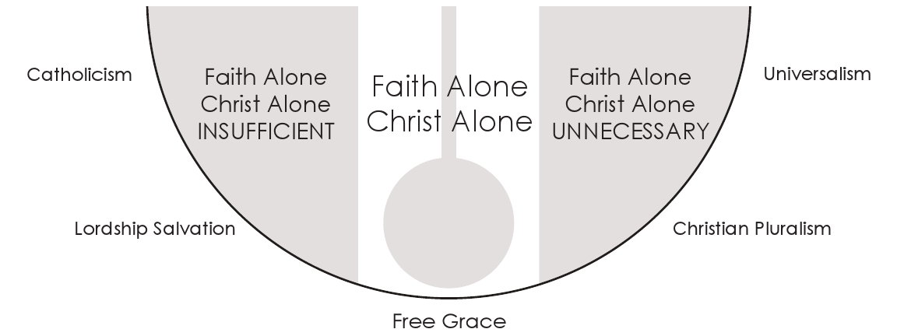

Slide 45
John 3:16
For God so loved the world that He gave His only begotten Son, that whoever believes in Him should not perish but have everlasting life.

Slide 46
John 10:28–29
And I give them eternal life, and they shall never perish; neither shall anyone snatch them out of My hand. My Father, who has given them to Me, is greater than all; and no one is able to snatch them out of My Father’s hand.

Slide 47
Acts 16:31
So they said, “Believe on the Lord Jesus Christ, and you will be saved, you and your household.”

Slide 48
Ephesians 2:8–9
For by grace you have been saved through faith, and that not of yourselves; it is the gift of God, not of works, lest anyone should boast.

Slide 50
Titus 3:5
not by works of righteousness which we have done, but according to His mercy He saved us, through the washing of regeneration and renewing of the Holy Spirit,

Slide 51
Hebrews 2:1
Therefore we must give the more earnest heed to the things we have heard, lest we drift away.

Slide 52
Ephesians 1:13
In Him you also trusted, after you heard the word of truth, the gospel of your salvation; in whom also, having believed, you were sealed with the Holy Spirit of promise,

Slide 54
James 2:17
Thus also faith by itself, if it does not have works, is dead.

Slide 55
James 2:23
Both [1] the Scripture was fulfilled which says,
“Abraham believed God, and it was accounted to him for righteousness.”

Slide 56
James 2:23
Both [1] the Scripture was fulfilled which says,
“Abraham believed God, and it was accounted to him for righteousness.”
[2] And he was called the friend of God.

Slide 57
James 2:23–24
Both [1] the Scripture was fulfilled which says,
“Abraham believed God, and it was accounted to him for righteousness.”
[2] And he was called the friend of God.
You see then that a man is not only
[1] called, “righteous” [by God] by faith, but also
[2] called, “righteous,” [by men] by works

Slide 59
John 14:6
Jesus said to him, “I am the way, the truth, and the life. No one comes to the Father except through Me.

Slide 60
2 Corinthians 5:19
that is, that God was in Christ reconciling the world to Himself, not imputing their trespasses to them, and has committed to us the word of reconciliation.

Slide 61
John 3:17–18
For God did not send His Son into the world to condemn the world, but that the world through Him might be saved. He who believes in Him is not condemned; but he who does not believe is condemned already, because he has not believed in the name of the only begotten Son of God.

Slide 63
Galatians 1:6–9
I marvel that you are turning away so soon from Him who called you in the grace of Christ, to a different gospel, which is not another; but there are some who trouble you and want to pervert the gospel of Christ. But even if we, or an angel from heaven, preach any other gospel to you than what we have preached to you, let him be accursed. As we have said before, so now I say again, if anyone preaches any other gospel to you than what you have received, let him be accursed.

Slide 64
John 20:30–31
And truly Jesus did many other signs in the presence of His disciples, which are not written in this book; but these are written that you may believe that Jesus is the Christ, the Son of God, and that believing you may have life in His name.

Slide 65
John 11:25–27
Jesus said to her, “I am the resurrection and the life. He who believes in Me, though he may die, he shall live. And whoever lives and believes in Me shall never die. Do you believe this?”
She said to Him, “Yes, Lord, I believe that You are the Christ, the Son of God, who is to come into the world.”

Slide 67
God’s Holiness
God’s Holiness Described
God’s Perfect Justice
Man’s Sinfulness
Hamartiology 101
Futility of Self-Righteousness
Errant Views
Hell
Its Reality
Reason for Hell
Errant Views
There’s no way we’re getting through all of this.
More next week!
Part II

Slide 68
STOP RECORDING, IDIOT
Part I: Soteriology in Christian Theology

