Slide 1
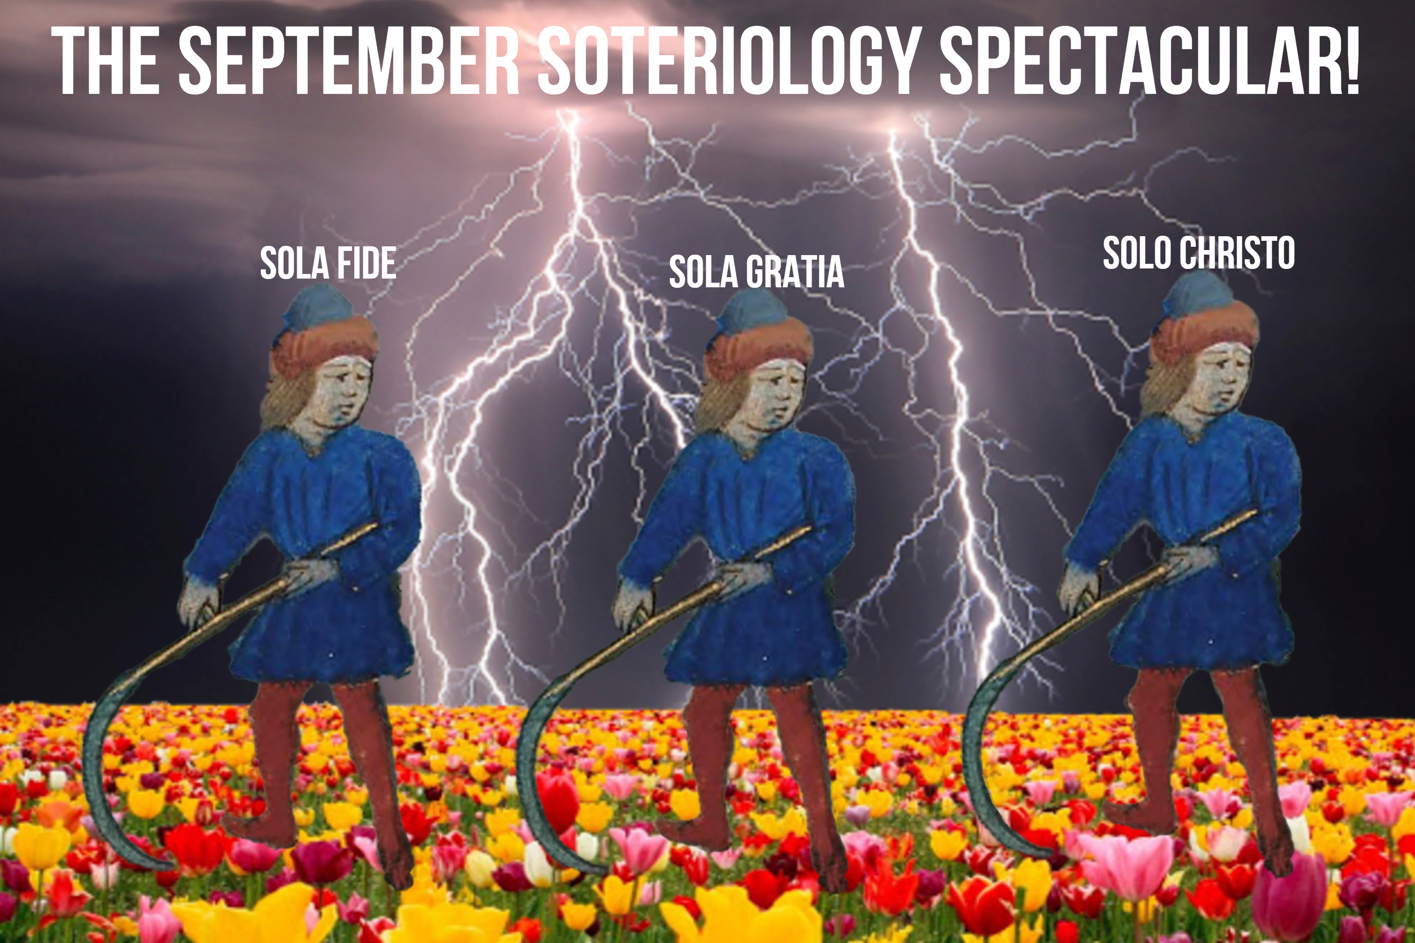
Part III: Atonement

Slide 2
DON’T FORGET TO PUSH THE RECORD BUTTON
Part III: Atonement

Slide 3
Review!
God cannot have relationship with that which is unholy!
God’s holiness demands separation from that which is unholy!
Judgment will separate God from that which is unholy.
You are of purer eyes than to behold evil, And cannot look on wickedness. Why do You look on those who deal treacherously, And hold Your tongue when the wicked devours A person more righteous than he?
(Hab. 1:3 NKJV)

Slide 4
Review!
God cannot have relationship with that which is unholy!
God’s holiness demands separation from that which is unholy!
Judgment will separate God from that which is unholy.
He shall judge the world in righteousness, And He shall administer judgment for the peoples in uprightness. (Psalm 9:8 NKJV)

Slide 5
Review!
God cannot have relationship with that which is unholy!
God’s holiness demands separation from that which is unholy!
Judgment will separate God from that which is unholy.
For in regard to the incapacity of the law, in that it was weak because of the flesh, by sending His own Son in the likeness of sinful flesh and as a sacrifice for sin, God pronounced sentence on sin in the flesh, (Rom. 8:3 ZCH)
κρίνω, [in LXX chiefly for שׁפט, also for דּין, ריב, etc.;] 1. to separate, select, choose (cl.; in LXX: 2 Mac 13:15).

Slide 6
Hell
False Views
Sheol / Hades / Lake of Fire
Jesus after the Crucifixion
The Future of Humanity
John 3:16
The Sin Barrier
What God Did
What Belief Assures
The Basics of Atonement
Linguistic Considerations
The Covering Sacrifices in the OT
The Removal Sacrifice at the Cross
Part III

Slide 7
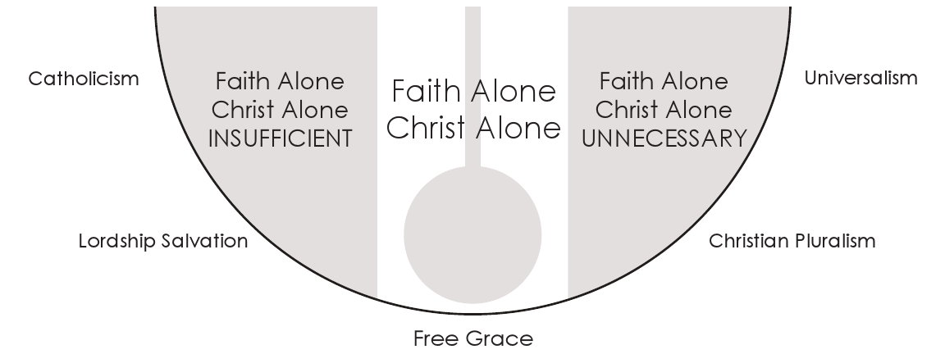

Slide 8
Before the time you first sinned you were the children of God and part of the Kingdom of God, but for your sins you have been made foul and evil, an instrument of the devil, the enemy of angels and slanderer of Holy Church, food for the false serpent and fuel for the flames of hell… You continue in your sinful way of life, which makes you rotten to the very core, like an animal wallowing in its own filth… Truly, sins are the paths that lead people to hell.
http://www.eleusinianm.co.uk/middle-english-literature-retold-in-modern-english/works-by-geoffrey-chaucer/the-parsons-tale

Slide 9
Before the time you first sinned you were the children of God and part of the Kingdom of God, but for your sins you have been made foul and evil, an instrument of the devil, the enemy of angels and slanderer of Holy Church, food for the false serpent and fuel for the flames of hell… You continue in your sinful way of life, which makes you rotten to the very core, like an animal wallowing in its own filth… Truly, sins are the paths that lead people to hell.
http://www.eleusinianm.co.uk/middle-english-literature-retold-in-modern-english/works-by-geoffrey-chaucer/the-parsons-tale

Slide 10
The traditional doctrine of hell is drawn more from pagan and mythological sources than from Scripture.
There is no Greek or Hebrew word in the Bible that is properly translated as “hell.”
Yet “hell” does exist … but not in the afterlife. Hell is the experience of some people (in varying degrees) during this life.
The ministry of Jesus and the task of the church is to rescue people from the hell they are living in.
https://redeeminggod.com/bible-theology-topics/universalim/

Slide 11
The traditional doctrine of hell is drawn more from pagan and mythological sources than from Scripture.
There is no Greek or Hebrew word in the Bible that is properly translated as “hell.”
Yet “hell” does exist … but not in the afterlife. Hell is the experience of some people (in varying degrees) during this life.
The ministry of Jesus and the task of the church is to rescue people from the hell they are living in.
https://redeeminggod.com/bible-theology-topics/universalim/

Slide 12
Hell
False Views
Sheol / Hades / Lake of Fire
Jesus after the Crucifixion
The Future of Humanity
John 3:16
The Sin Barrier
What God Did
What Belief Assures
The Basics of Atonement
Linguistic Considerations
The Covering Sacrifices in the OT
The Removal Sacrifice at the Cross
Part III

Slide 13
Sheol / Hades
Two Sides (Luke 16:19–31)
Paradise
OT Saints, Abraham’s Bosom, Thief on Cross
Now Empty (Inhabitants Relocated to Heaven)
Not Paradise
Three Compartments
Chasma
A gulf between the torments and Paradise. Both sides communicate.
(Luke 16:26)
Lake of Fire
(Rev. 20:7–15)
Final Destination For
All Unsaved Humans
And All Fallen Angels
Basanos
Place of Torment for Unbelievers
(Luke 16:23)
The Abyss
Abode for Some Fallen Angels
(Luke 8:31; Rev. 9; 17; 20)
Tartarus
Fallen Angels of Gen. 6
(2 Peter 2:4–11)

Slide 14
Mosaic Law
Church Age
Paradise
OT Saints, Thief on Cross

Slide 15
1. Paradise
Mosaic Law
Church Age
And Jesus said to him, “Assuredly, I say to you, today you will be with Me in Paradise.” (Luke 23:43)
Paradise
OT Saints, Thief on Cross

Slide 16
2. Resurrection
Mosaic Law
Church Age
Now the first day of the week Mary Magdalene went to the tomb early... Jesus said to her, “Do not cling to Me, for I have not yet ascended to My Father; but go to My brethren and say to them, ‘I am ascending to My Father and your Father, and to My God and your God.’
(John 20:1a, 17)
Paradise
OT Saints, Thief on Cross

Slide 17
Heaven
OT Saints, Thief on Cross
3. Back to Paradise to Collect the Saints
4. To Heaven with the Saints
(Therefore He says:
“When He ascended on high, He led captivity captive, And gave gifts to men.”
(Now this, “He ascended”—what does it mean but that He also first descended into the lower parts of the earth? He who descended is also the One who ascended far above all the heavens, that He might fill all things.) (Eph. 4:8–10 cf. Col. 2:15)
Mosaic Law
Church Age
Paradise
Empty

Slide 18
Heaven
OT Saints, Thief on Cross
5. Appearance to Disciples
Mosaic Law
Church Age
Then, the same day at evening, being the first day of the week, when the doors were shut where the disciples were assembled, for fear of the Jews, Jesus came and stood in the midst, and said to them, “Peace be with you.”
(John 20:19)
Paradise
Empty

Slide 19
Heaven
OT Saints, Thief on Cross
6. Back to Heaven
Mosaic Law
Church Age
Now when He had spoken these things, while they watched, He was taken up, and a cloud received Him out of their sight.
(Acts 1:9)
Paradise
Empty

Slide 20
Heaven
Mosaic Law
Church Age
7-Year Tribulation
Messianic Kingdom
Eternal State
Land
Seed
Blessing
Rapture
Return of Christ
Paradise
We are confident, yes, well pleased rather to be absent from the body and to be present with the Lord. (2 Cor. 5:8)

Slide 21
Heaven
Mosaic Law
Church Age
7-Year Tribulation
Messianic Kingdom
Eternal State
Land
Seed
Blessing
Rapture
Return of Christ
Paradise
We are confident, yes, well pleased rather to be absent from the body and to be present with the Lord. (2 Cor. 5:8)

Slide 22
Tribulation
Eternal State
1000-Year Messianic Kingdom (Rev 20:4–6)
Return of Christ
With the Saints
(Rev 19:11–16)
Land
Seed
Blessing
Sheep and Goats Judgment For Tribulation Survivors
(Matt 25:31–46)
Judgement Seat of Christ For Believers
(1 Cor 3:10–15; 2 Cor 5:9–10; Rom 14:10)
Satan Leads
Final Rebellion
(Rev 20:7-10)
New Heaven, New Earth
For Believers
(Rev 21:1–22:5)
Armageddon
(Ezek 39)
Satan bound in Hades (Rev 20:1-5)
Great White Throne,
Lake of Fire
For Unbelievers
(Rev 20:11–15)

Slide 23
Hell
False Views
Sheol / Hades / Lake of Fire
Jesus after the Crucifixion
The Future of Humanity
John 3:16
The Sin Barrier
What God Did
What Belief Assures
The Basics of Atonement
Linguistic Considerations
The Covering Sacrifices in the OT
The Removal Sacrifice at the Cross
Part III

Slide 24
For God so loved the world that He gave His only begotten Son, that whoever believes in Him should not perish but have everlasting life. (John 3:16 NKJV)

Slide 25
God
John 3:16
The World

Slide 26
God
John 3:16
SIN
The World
Perish

Slide 27
God
John 3:16
SIN
Jesus
The World
Perish

Slide 28
God
John 3:16
SIN
Jesus
Believes
The World
Perish

Slide 29
God
John 3:16
SIN
Jesus
Believes
The World
Perish

Slide 30
God
John 3:16
SIN
Jesus
Believes
The World
Everlasting Life
Perish

Slide 31
God
God
John 3:16
“Atonement”
SIN
An overly-simplified theological term that probably shouldn’t be used like it is…
The World
The World
Perish
Perish

Slide 32
Hell
False Views
Sheol / Hades / Lake of Fire
Jesus after the Crucifixion
The Future of Humanity
John 3:16
The Sin Barrier
What God Did
What Belief Assures
The Basics of Atonement
Linguistic Considerations
The Covering Sacrifices in the OT
The Removal Sacrifice at the Cross
Part III

Slide 33
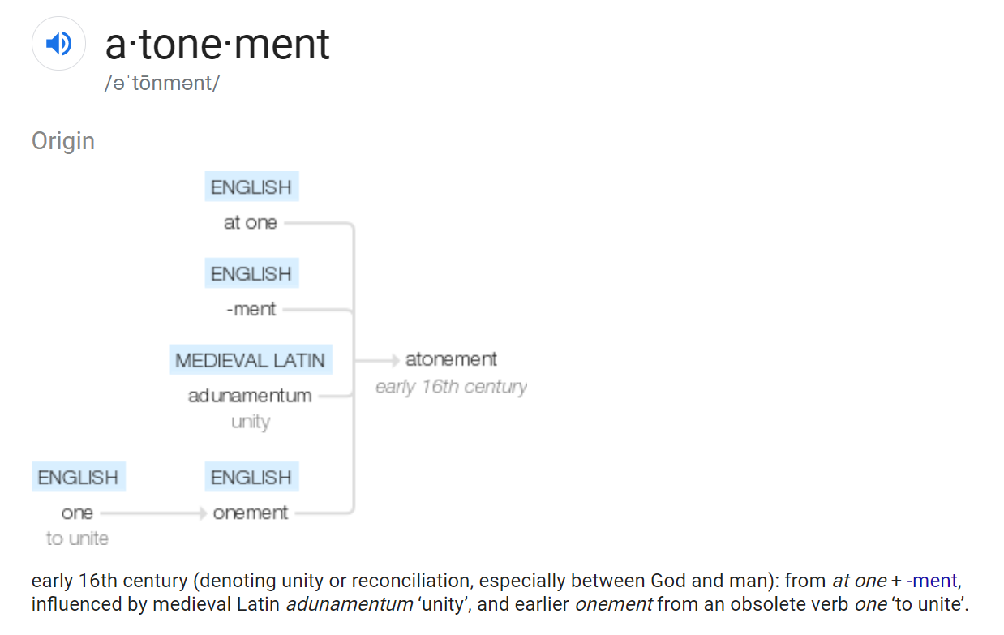

Slide 34
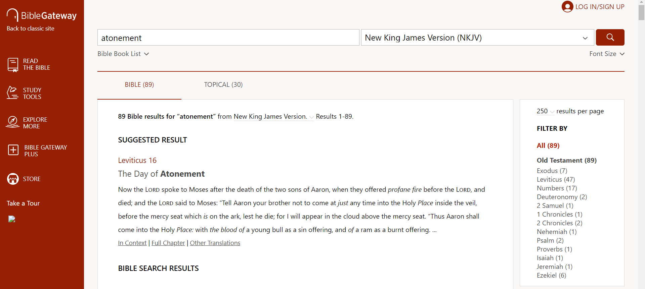

Slide 35
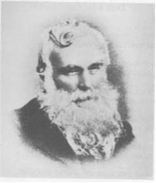
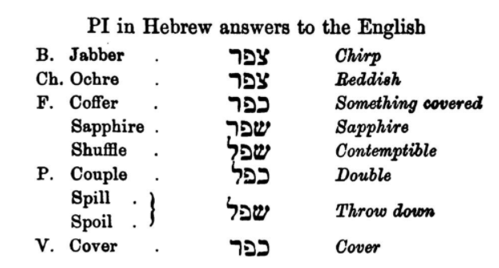
Robert Govett (1813–1901)
Robert Govett, English derived from Hebrew, 1869.

Slide 36
I. כפר
I. כֹּפֶר n.m. the price of a life, ransom — 1. a price for ransom of a life; לְ ˊכ ransom for; alone. 2. in ritual נַפְשׁוֹ ˊכ is a half shekel of the sanctuary paid by each male above twenty years at the census in order that there might be no plague upon them. It was offered to Yahweh, לְכַפֵּר על to atone for them.
כִּפֶּר vb. Pi. etc. denom. cover over (fig.), pacify, make propitiation — 1. cover over, pacify, propitiate; pacify the wrath of a king (e.g. by a gift). 2. cover over, atone for sin, without sacrifice: a. man as subj.; c. על of persons b. with God as subj., c. acc. pers., cover, i.e. treat as covered, view propitiously, Yahweh’s land (song); לְ pers. (bloodguiltiness flows away in the stream); בְּעַד of person; c. acc. of the sin; עַל of sin. It is conceived that God in his sovereignty may himself provide an atonement or covering for men and their sins which could not be provided by men. 3. cover over, atone for sin and persons by legal rites; a. c. acc. of sacred places (by the great sin-offering of the day of atonement), (by the blood of the sin-offering). b. usually c. עַל (I) of things, e.g. of the altar to which the blood of the sin-offering was applied; and specifically the horns of the altar; the holy place of the tabernacle (by the great sin-offering, because of (מִן) the uncleannesses of the children of Israel and because of their transgressions); for the leprous house by ceremony of purification; for the goat לעזאזל (which was presented before Yahweh to consecrate him for the bearing away of the sins of the people). (2) of persons, על־נפשׁתיכם, for your persons, yourselves, e.g. by the payment of atonement-money כֶּסֶף הַכִּפֻרִים at the census; by the קרבן of the spoils; by the blood upon the altar; in the ritual עֲלֵיהֶם, עָלָיו by ministry of priest through the blood of the sin-offering; of the trespass-offering; the whole burnt-offering; by the oil used in purifying a leper; by the priestly ministry in general; by the substitution of the Levites for the firstborn. Underlying all these offerings there is the conception that the persons offering are covered by that which is regarded as sufficient and satisfactory by Yahweh. (The purpose of the covering is stated shall atonement be made for you to cleanse you, from all your sins shalt ye be clean before Yahweh.) c. the need of the atonement is expressed by מִן (others understand מִן as = away from): מֵחטאתו because of his sin; also עַל, עַל־חַטָּאתוֹ on account of his sin. d. c. בְּ instr. בְּאֵיל; with a trespass-offering; כִּי־הַדָּם הוּא בַּנֶּפֶשׁ יְכַפֵּר for it is the blood with the living being that covers over; c. בְּ loc. e. c. בַּעַד pers., on behalf of (by Aaron), (by the prince). Pu. be covered over, atoned for. 1. apart from the ritual; (by the touch of the live coal from the altar); c. בְּ instr. by this. 2. c. לְ for whom; in ritual, c. בְּ instr. אֲשֶׁר כֻּפַּר בָּהֶם wherewith atonement was made (ram of consecration). Hithp. c. בְּ instr. be covered by (cf. Pu.). Nithp. be covered.
כִּפֻּרִים n.pl.abstr. atonement ˊהַטַּאת הכּ sin-offering of the atonement; ˊכ(ה) יוֹם day of (the) atonement; ˊכֶּסֶף הכ money of atonement.
כַּפֹּרֶת n. propitiatory, late techn. word from כּפר cover over sin; the older explan. cover, lid has no justification in usage; it was a slab of gold 2 1/2 cubits x 1 1/2 c. placed on top of the ark of the testimony. On it, and a part of it, were two golden cherubim facing each other, whose outstretched wings came together above and constituted the throne of Yahweh. When the high priest entered the Holy of Holies on the day of atonement it was necessary that this highest place of atonement should be enveloped in a cloud of incense. The blood of the sin-offering of the atonement was then sprinkled on the face of and seven times before it. The temple proper, as distinguished from porch etc., was called ˊבֵּית הַכּ.
Richard Whitaker et al., The Abridged Brown-Driver-Briggs Hebrew-English Lexicon of the Old Testament (Boston; New York: Houghton, Mifflin and Company, 1906).

Slide 37
Source : Bailis Shamun
Eastern Syriac : | ܟܵܦܹܪ
Western Syriac : | ܟܳܦܶܪ
Root : | ܟܦܪ
Eastern phonetic : | ' ka: pi:r
Category : | verb
English : | 1) transitive : to purify , to make pure ; 2) see also ܓܵܕܹܦ / ܛܲܢܸܦ / ܣܲܝܸܒ݂ / ܛܲܡܹܐ / ܫܲܚܸܡ : to profane , to desacrate / to treat sacrilegiously , to violate , to debase by a wrong / unworthy / vulgar use , to defile , figurative sense ; in a beautiful landscape ... : to be an eyesore (?) ; 3) transitive and intransitive ; followed by ܒ ; one's faith, statements (?), opinions(?) ... ; see also ܥܵܒܹܪ / ܒܵܪܹܐ / ܫܵܒܹܩ / ܬܲܪܸܓ / ܪܲܦܹܐ / ܢܵܟܹܪ : to recant / to formally withdraw or repudiate a statement or belief , to publicly renounce / to publicly denounce / to disavow a person ?, an action ?... , to withdraw (?) / to retract one's words ... (?) , to take back (?) / to unsay (?) , to abjure / to forswear a doctrinal error ... / to swear off / to abnegate one's God , to resile of a course of action ... (?) ; ܟܵܦܹܪ ܒܬܵܘܕܝܼܬܵܐ : to recant one's faith ; 4 Bailis Shamun ; intransitive ; followed by ܡܸܢ : see also ܣܵܛܹܐ / ܨܵܠܹܐ / ܦܵܠܹܛ : to renegade , to become a renegade , to desert one's faith / to become unfaithful to one's religion / to be a traitor to one's cause ; 5) intransitive ; see also ܢܵܩܹܕ / ܕܵܟܹܐ / ܡܵܪܹܩ / ܫܵܐܹܓ݂ / ܬܵܡܹܙ : to be purified , to become purified , to be pure , to become pure , to be cleansed , to be disinfected / decontaminated ;
https://www.assyrianlanguages.org/sureth/dosearch.php?searchkey=34546&language=id

Slide 38
Hell
False Views
Sheol / Hades / Lake of Fire
Jesus after the Crucifixion
The Future of Humanity
John 3:16
The Sin Barrier
What God Did
What Belief Assures
The Basics of Atonement
Linguistic Considerations
The Covering Sacrifices in the OT
The Removal Sacrifice at the Cross
Part III

Slide 39
https://www.instagram.com/p/B9Envb3qbOK/

Slide 40
יוֹם כִּיפּוּר
ἡμέρα ἐξιλασμοῦ
ἐξιλασμός
H3727
כַּפֹּרֶת
kappôreth
kap-po'-reth
From H3722; a lid (used only of the cover of the sacred Ark): - mercy seat.
Total KJV occurrences: 27
G2435
ἱλαστήριον
hilastērion
Total KJV Occurrences: 2
mercyseat, 1
Heb_9:5
propitiation, 1
Rom_3:25
H3727
כּפּרת
kappôreth
BDB Definition:
1) mercy-seat, place of atonement
1a) the golden plate of propitiation on which the High Priest sprinkled the seat 7 times on the Day of Atonement symbolically reconciling Jehovah and His chosen people
1a1) the slab of gold on top of the ark of the covenant which measured 2.5 by 1.5 cubits; on it and part of it were the two golden cherubim facing each other whose outstretched wings came together above and constituted the throne of God
Part of Speech: noun feminine
A Related Word by BDB/Strong’s Number: from H3722

Slide 41
Yom Kippur
16 Now the Lord spoke to Moses after the death of the two sons of Aaron, when they offered profane fire before the Lord, and died; ² and the Lord said to Moses: “Tell Aaron your brother not to come at just any time into the Holy Place inside the veil, before the mercy seat which is on the ark, lest he die; for I will appear in the cloud above the mercy seat…
²⁹ “This shall be a statute forever for you: In the seventh month, on the tenth day of the month, you shall afflict your souls, and do no work at all, whether a native of your own country or a stranger who dwells among you. ³⁰ For on that day the priest shall make atonement for you, to cleanse you, that you may be clean from all your sins before the Lord.
(Lev. 16:1, 2, 29, 30 NKJV)
¹³ And he shall put the incense on the fire before the Lord, that the cloud of incense may cover the mercy seat that is on the Testimony, lest he die. ¹⁴ He shall take some of the blood of the bull and sprinkle it with his finger on the mercy seat on the east side; and before the mercy seat he shall sprinkle some of the blood with his finger seven times.
¹⁵ “Then he shall kill the goat of the sin offering, which is for the people, bring its blood inside the veil, do with that blood as he did with the blood of the bull, and sprinkle it on the mercy seat and before the mercy seat. ¹⁶ So he shall make atonement for the Holy Place, because of the uncleanness of the children of Israel, and because of their transgressions, for all their sins; and so he shall do for the tabernacle of meeting which remains among them in the midst of their uncleanness.
(Lev. 16:13–16 NKJV)

Slide 42
10 For the law, having a shadow of the good things to come, and not the very image of the things, can never with these same sacrifices, which they offer continually year by year, make those who approach perfect. ² For then would they not have ceased to be offered? For the worshipers, once purified, would have had no more consciousness of sins. ³ But in those sacrifices there is a reminder of sins every year. ⁴ For it is not possible that the blood of bulls and goats could take away sins.
(Hebrews 10:1–4)

Slide 43
The next day John saw Jesus coming toward him, and said, “Behold! The Lamb of God who takes away the sin of the world!
(John 1:29)
Τῇ ἐπαύριον βλέπει ὁ ᾿Ιωάννης τὸν ᾿Ιησοῦν ἐρχόμενον πρὸς αὐτόν καὶ λέγει· ἴδε ὁ ἀμνὸς τοῦ Θεοῦ ὁ αἴρων τὴν ἁμαρτίαν τοῦ κόσμου.
For it is not possible that the blood of bulls and goats could take away sins.
ἀδύνατον γὰρ αἷμα ταύρων καὶ τράγων ἀφαιρεῖν ἁμαρτίας.

Slide 44
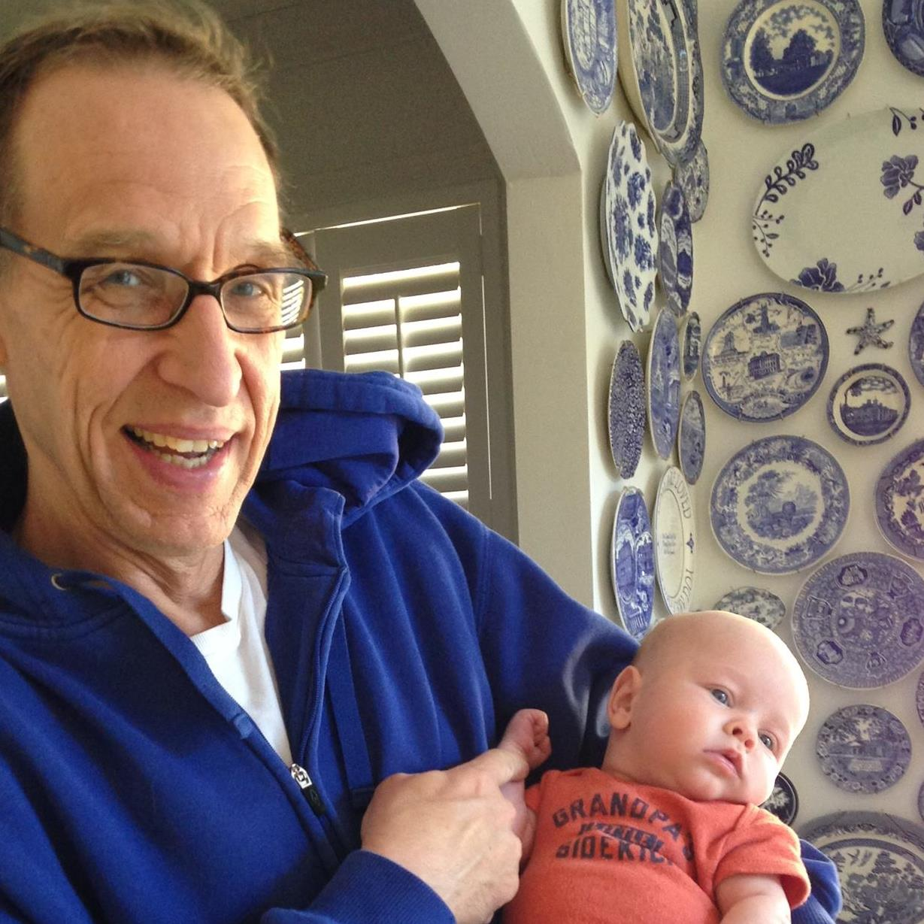
The blood of animals cannot take away sins. Certainly God commanded the people to perform these sacrifices. When people of faith did so, they would be blessed by God because of their obedience. However, true forgiveness was not found in them. Forgiveness was given only in the sense that God did not judge the people for their sins in light of the coming sacrifice He would provide. It would be in this coming sacrifice that forgiveness would be found for believers under the Old and New Covenants.
Eternal life is given by faith alone. In the OT it was given to those who believed in the coming Messiah. The reason God can give eternal life is because the sins of those who believe have been dealt with once for all. The fact that these sacrifices in the old system were offered over and over again was a reminder that the blood of those animals was not the place to find that forgiveness.
And how could they? How could the blood of a dumb, unwilling animal take care of the sins of God’s people once for all? How could it give such peace and allow unfettered access into the presence of God?
But all that leads to another question. In Hebrews 1 Jesus is described as the eternal God, the Creator of all things. How could His blood not accomplish what God wanted in a sacrifice?
Ken Yates
Ken Yates, Hebrews: Partners with Christ, 148–149.

Slide 45
For even the Son of Man did not come to be served, but to serve, and to give His life a ransom for many [καὶ δοῦναι τὴν ψυχὴν αὐτοῦ λύτρον ἀντὶ πολλῶν].”
(Mark 10:45; cf. Matt. 20:28)
“instead of, in the place of, as a substitute for”
anti- and huper- =
¹⁴ For the love of Christ compels us, because we judge thus: that if One died for all [ὑπὲρ πάντων ἀπέθανεν], then all died; ¹⁵ and He died for all, that those who live should live no longer for themselves, but for Him who died for them [ὑπὲρ αὐτῶν ἀποθανόντι] and rose again. (2 Cor. 5:14, 15)
Or if he asks for a fish, will he give him a serpent instead of a fish [ἀντὶ ἰχθύος ὄφιν]? (Luke 11:11b)
⁵ For there is one God and one Mediator between God and men, the Man Christ Jesus, ⁶ who gave Himself a ransom for all [ἀντίλυτρον ὑπὲρ πάντων], to be testified in due time, (1 Tim. 2:5, 6)
See also:
Matt. 26:28; Mark 14:24; Luke 22:20; John 6:51; 10:11; 15:13; Rom 5:6, 8; 1:32; 1 Cor. 15:3; 2 Cor 5:21; Gal. 1:4; 2:20; 3:13; Ephesians 5:2; Titus 2:14; Heb. 2:9; 1 Pet. 3:18

Slide 46
Hell
False Views
Sheol / Hades / Lake of Fire
Jesus after the Crucifixion
The Future of Humanity
John 3:16
The Sin Barrier
What God Did
What Belief Assures
The Basics of Atonement
Linguistic Considerations
The Covering Sacrifices in the OT
The Removal Sacrifice at the Cross
Part III
Next time…

Slide 49
STOP RECORDING, IDIOT
Part I: Soteriology in Christian Theology

