Slide 1
Part V: Faith

Slide 2
DON’T FORGET TO PUSH THE RECORD BUTTON
Part V: Faith

Slide 3
Review!

Slide 4
Historical Theology
Bibliology
Theology Proper
Christology
Pneumatology
Angelology
Anthropology
Hamartiology
Soteriology
Israelology
Ecclesiology
Eschatology
Dogmatic Theology
Systematic Theology
Biblical Theology

Slide 5
Three Phases of Individual Salvation
 | Justification | Sanctification | Glorification
From: | Penalty of Sin | Power of Sin | Presence of Sin
When: | Past | Present | Future
How: | Through faith alone in Christ alone | Through daily dependence on HS | Death or Rapture
Sample Texts: | Eph. 2:8–9; Titus 3:5 | Phil. 2:12; Jas. 1:21 | Rom. 13:11; 1 Thess. 5:8–9

Slide 6
Heaven
Mosaic Law
Church Age
7-Year Tribulation
Messianic Kingdom
Eternal State
Land
Seed
Blessing
Rapture
Return of Christ
Paradise
We are confident, yes, well pleased rather to be absent from the body and to be present with the Lord. (2 Cor. 5:8)

Slide 7
God
God
John 3:16
“Atonement”
SIN
An overly-simplified theological term that probably shouldn’t be used like it is…
The World
The World
Perish
Perish

Slide 8
Fancy Theological Terms
Redemption
Propitiation
Expiation
Reconciliation
Substitution
Regeneration
Imputation
From Part IV

Slide 9
Growing Fellowship
Hindered Fellowship
God
Believer in Christ
Sanctification Reconciliation
we implore you on Christ’s behalf, be reconciled to God.
Universal Reconciliation
SIN
Justification Reconciliation
No sin barrier!
The World

Slide 10
Tribulation
Eternal State
1000-Year Messianic Kingdom (Rev 20:4–6)
Return of Christ
With the Saints
(Rev 19:11–16)
Land
Seed
Blessing
Sheep and Goats Judgment For Tribulation Survivors
(Matt 25:31–46)
Judgement Seat of Christ For Believers
(1 Cor 3:10–15; 2 Cor 5:9–10; Rom 14:10)
Satan Leads
Final Rebellion
(Rev 20:7-10)
New Heaven, New Earth
For Believers
(Rev 21:1–22:5)
Armageddon
(Ezek 39)
Satan bound in Hades (Rev 20:1-5)
Great White Throne,
Lake of Fire
For Unbelievers
(Rev 20:11–15)

Slide 11
Faith
πιστεύω (pisteuō); πίστις (pistis)
Attempted redefinitions:
Faith/Belief distinction
James 2
Notitia, assensus, fiducia
Some final thoughts
Part V

Slide 12
Faith
πιστεύω (pisteuō); πίστις (pistis)
Attempted redefinitions:
Faith/Belief distinction
James 2
Notitia, assensus, fiducia
Some final thoughts
Part V

Slide 13
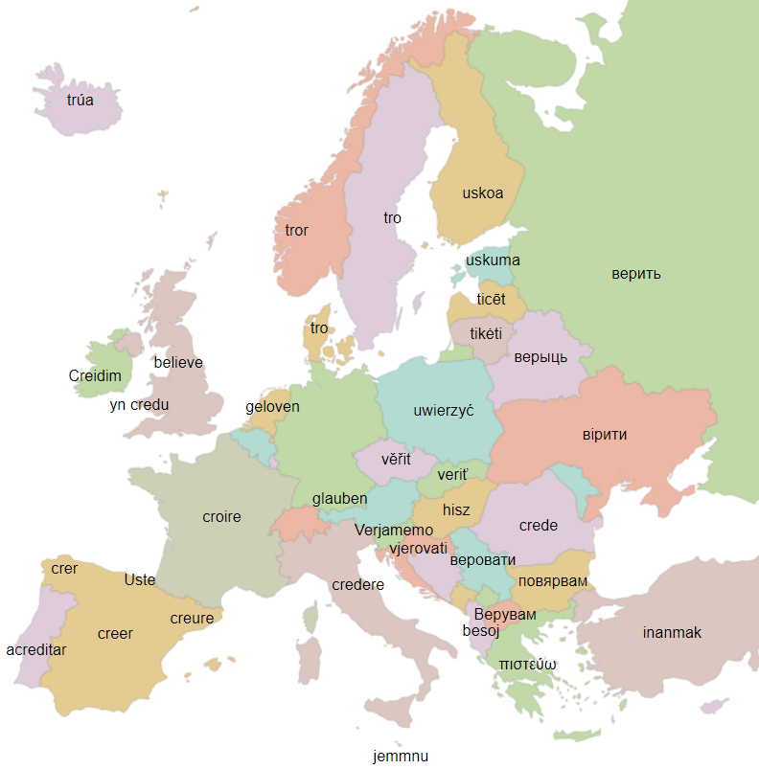
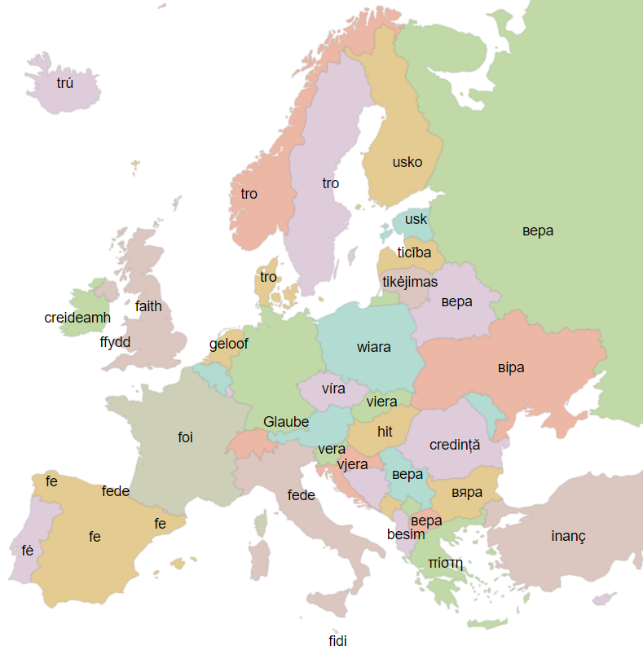
πιστεύω (pisteuō) πίστις (pistis)
https://ukdataexplorer.com/european-translator

Slide 14
“Belief” “Faith”

Slide 15
Faith
πιστεύω (pisteuō); πίστις (pistis)
Attempted redefinitions:
Faith/Belief distinction
James 2
Notitia, assensus, fiducia
Some final thoughts
Part V

Slide 16
Controversy #1 — James 2:14
Τί τὸ ὄφελος, ἀδελφοί μου, ἐὰν πίστιν λέγῃ τις ἔχειν, ἔργα δὲ μὴ ἔχῃ; μὴ δύναται ἡ πίστις σῶσαι αὐτόν;
What good is it, my brothers, if someone says he has faith but does not have works? Can that faith save him? (ESV)
Of what benefit is it, my brothers, if someone says he has faith but he does not have works? That faith cannot save him, can it? (NWT)
What does it profit, my brothers, if someone says he has faith but does not have works? Is that kind of faith able to save him? (EMTV)
What doth it profit, my brethren, though a man say he hath faith, and have not works? can faith save him? (KJV)
What is the profit, my brethren, if any one say he have faith, but have not works? can faith save him? (DARBY)
What good is it, my brothers, if someone says he has faith but does not have works? Can his faith save him? (HCSB)
Why is “that” missing in James 2:17, 22, 26?

Slide 17
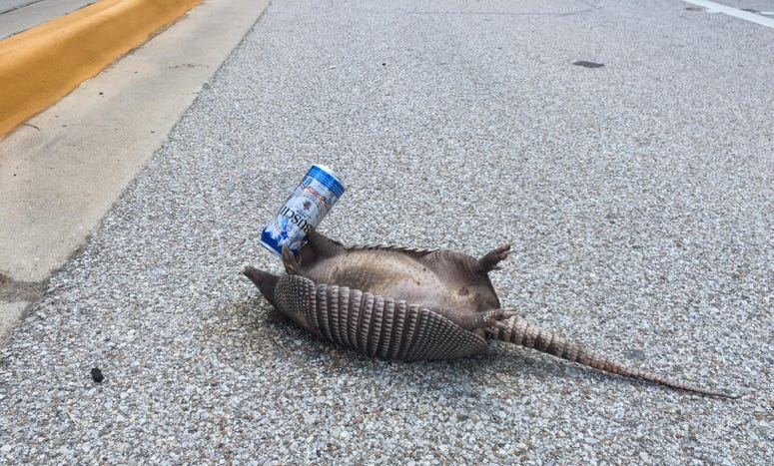
Controversy #2 — James 2:17
So also faith by itself, if it does not have works, is dead. (ESV)
(Note: “that” is missing in translation…)
Do you want to be shown, you foolish person, that faith apart from works is useless? (James 2:20 ESV)
Common argument, but not preferable.
Sample text from Codex Ephraemi Rescriptus (James 1:21–25)
Dead armadillo is dead.

Slide 18
Controversy #3 — James 2:24
Ye see that by works a man is justified, and not only by faith. (ASV)
You see that a man is to be declared righteous by works and not by faith alone. (NWT)
καὶ οὐκ ἐκ πίστεως μόνον.
kai ouk ek pisteos monon.
and not only [justified] by faith. (ASV)
καὶ οὐκ ἐκ πίστεως μόνον.
kai ouk ek pisteos mones.
and not [justified] by faith alone. (NWT)
James 2:24
ὁρᾶτε τοίνυν ὅτι ἐξ ἔργων δικαιοῦται ἄνθρωπος καὶ οὐκ ἐκ πίστεως μόνον.
kai ouk ek pisteos monon.
Ye see that by works a man is justified, and not only [justified] by faith. (ASV)

Slide 19
Faith
πιστεύω (pisteuō); πίστις (pistis)
Attempted redefinitions:
Faith/Belief distinction
James 2
Notitia, assensus, fiducia
Some final thoughts
Part V

Slide 20
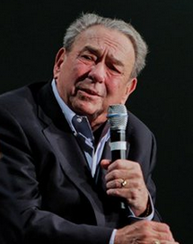
The Protestant Reformers recognized that biblical faith has three essential aspects: notitia, assensus, and fiducia.
Notitia. Notitia refers to the content of faith, or those things that we believe. We place our faith in something, or more appropriately, someone. In order to believe, we must know something about that someone, who is the Lord Jesus Christ…
R.C. Sproul (1939–2017)
https://www.ligonier.org/learn/devotionals/faith-defined/

Slide 21
The Protestant Reformers recognized that biblical faith has three essential aspects: notitia, assensus, and fiducia.
…Assensus. Assensus is our conviction that the content of our faith is true. You can know about the Christian faith and yet believe that it is not true. Genuine faith says that the content — the notitia taught by Holy Scripture — is true.
R.C. Sproul (1939–2017)
https://www.ligonier.org/learn/devotionals/faith-defined/

Slide 22
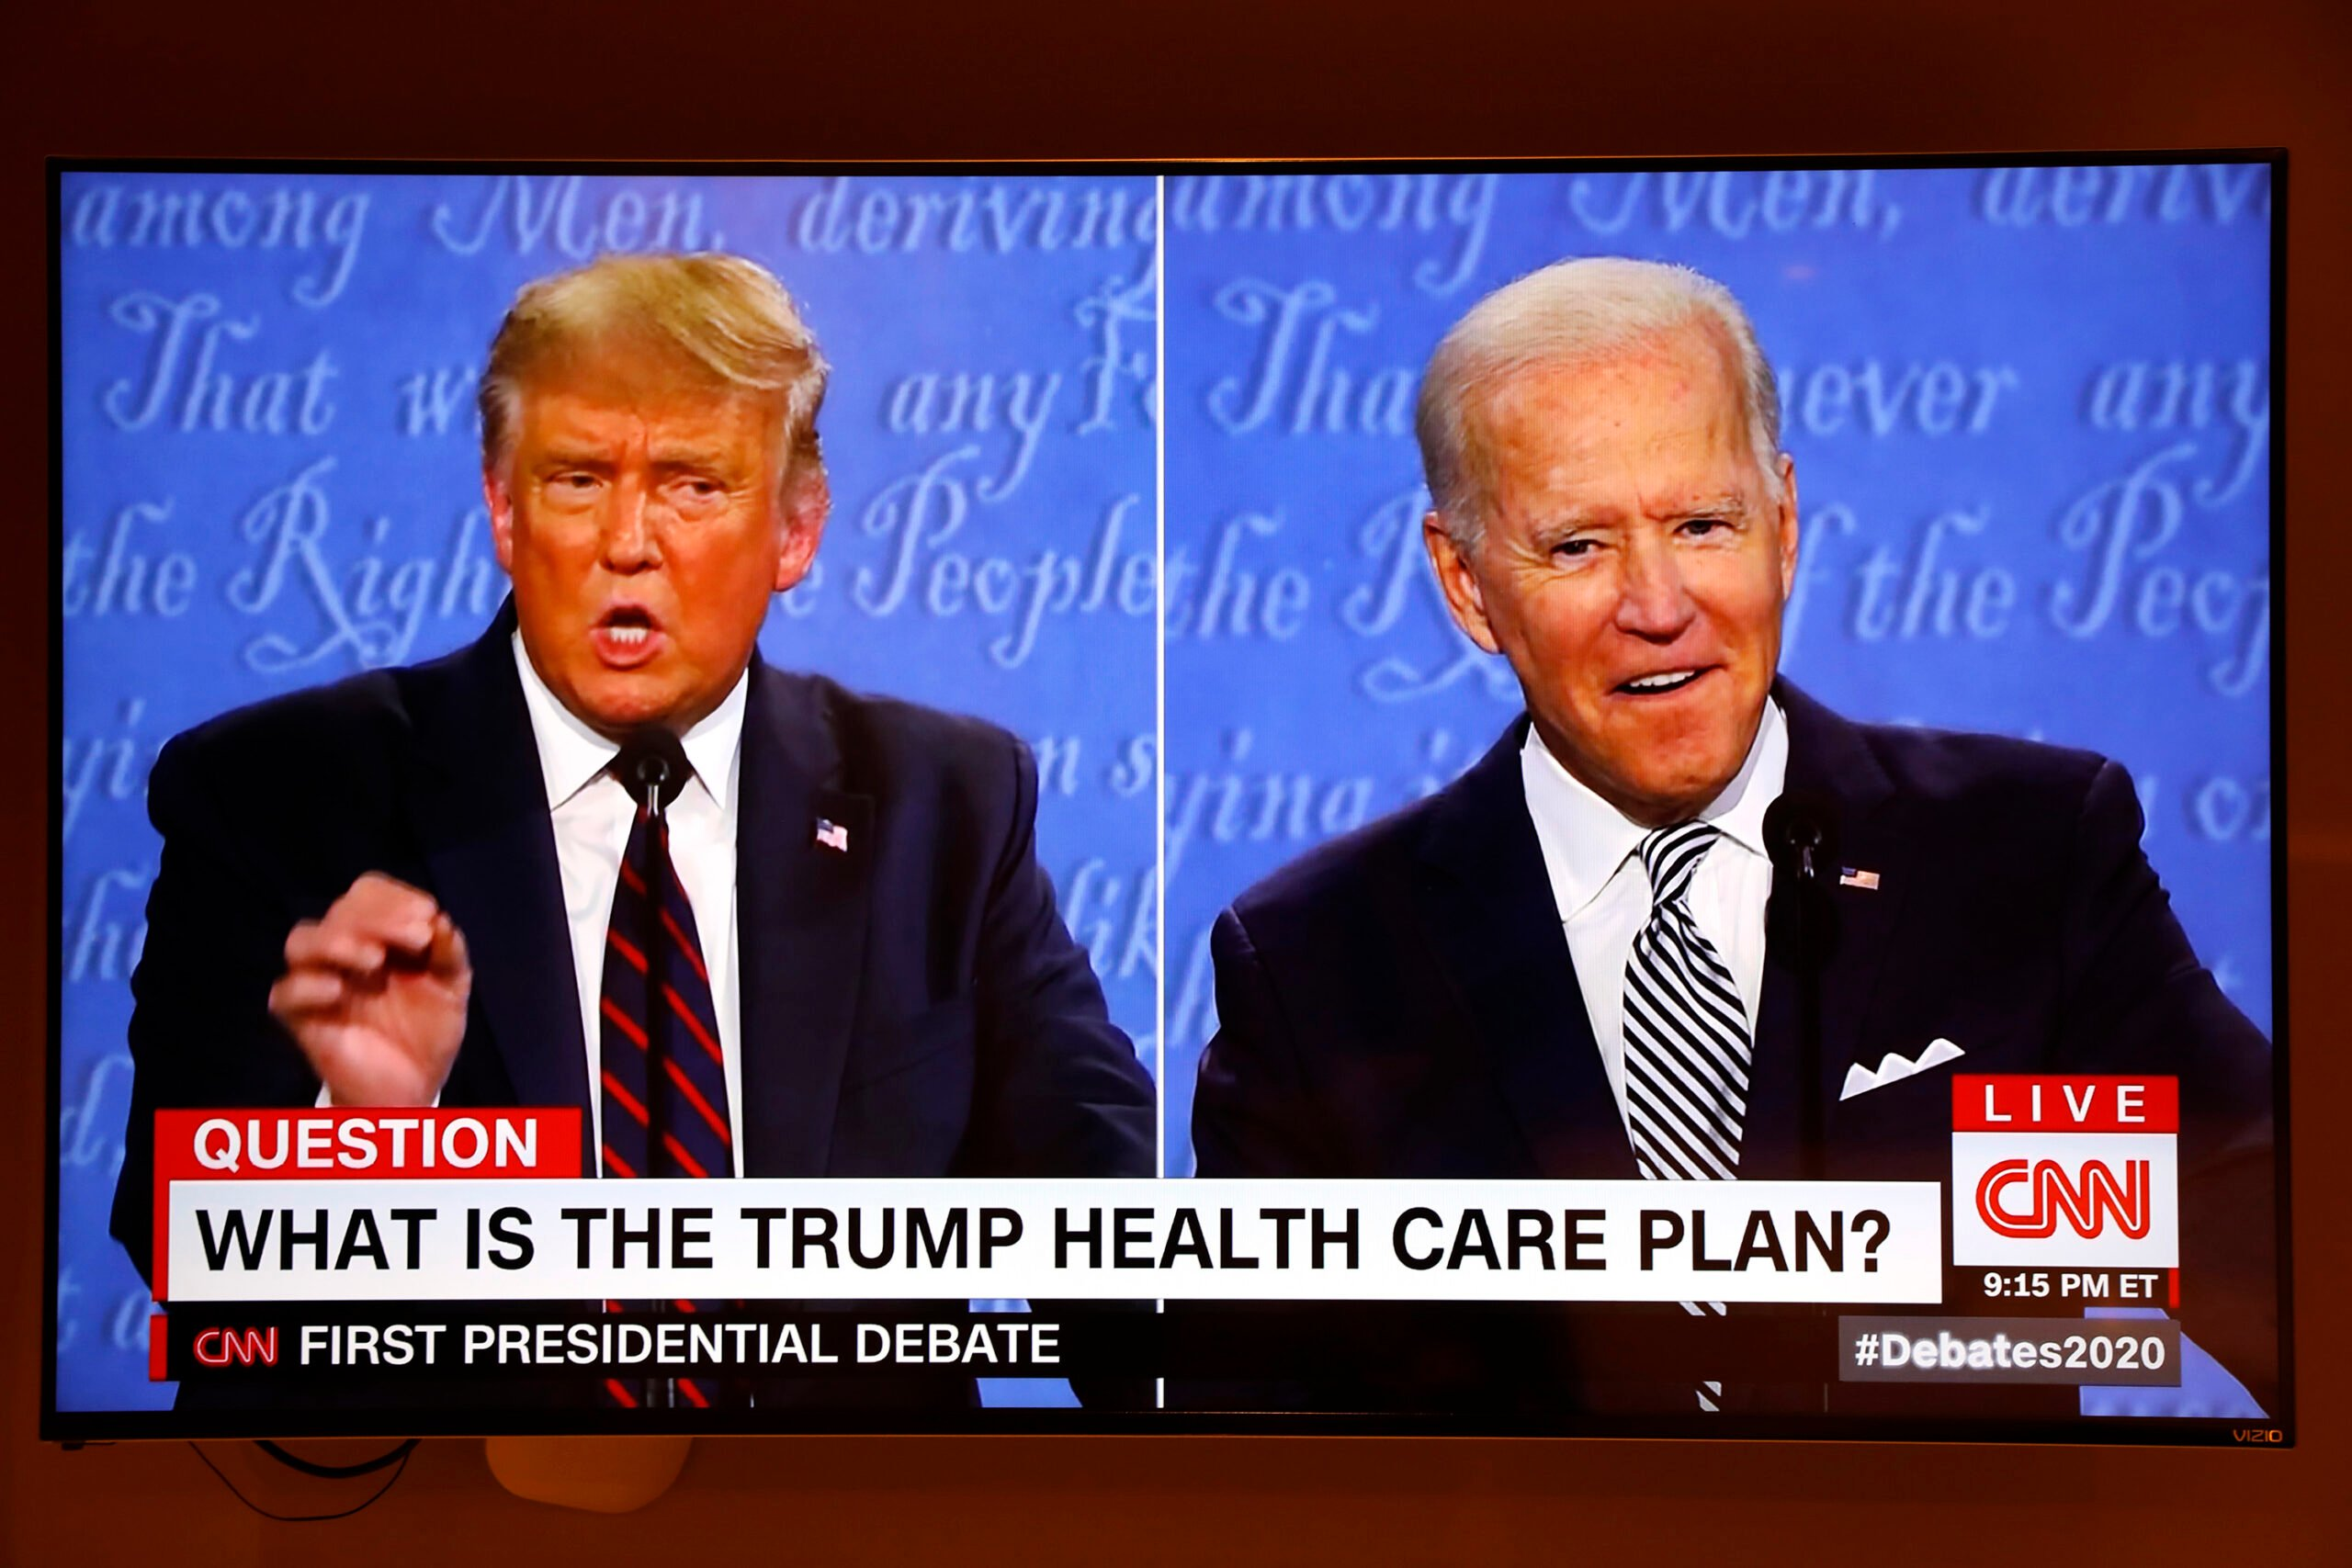

Slide 23
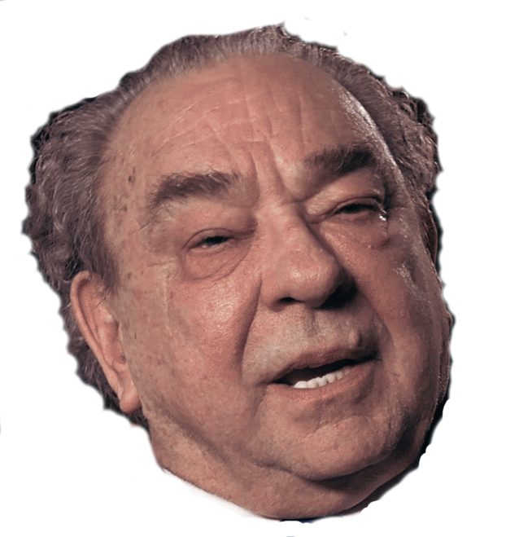
WHAT IS FIDUCIA?
REFORMED THEOLOGY VS. REFORMED THEOLOGY

Slide 24
Fiducia. Fiducia refers to personal trust and reliance. Knowing and believing the content of the Christian faith is not enough, for even demons can do that (James 2:19). Faith is only effectual if, knowing about and assenting to the claims of Jesus, one personally trusts in Him alone for salvation.
https://www.ligonier.org/learn/devotionals/faith-defined/
Thus, the Protestant Reformers understood there to be a third element: fiducia (fi-DU-chi-ah). Fiducia is the act of trust, by which our heart embraces, trusts in, and personally rests upon Christ for our salvation. Fiducia means that we submit to Christ as Savior and Lord, that we own Him as King and rest in His saving work for us. Fiducia means that true faith involves faithfulness, loyalty to Christ.
https://www.ligonier.org/learn/devotionals/true-faith/

Slide 25
Notitia
nōtĭtĭa , ae (I.gen. sing. notitiāï, Lucr. 2, 124.—Collat. form nōtĭtĭes , Lucr. 5, 182; 1047; Vitr. 6 prooem.), f. 1. notus, a being known, celebrity, note, fame.
I. Lit. (very rare): “hi propter notitiam sunt intromissi,” Nep. Dion. 9, 4: “tanta notitia te invasit,” Sen. Ep. 19, 3: “plus notitiae quam fuit ante dedit,” Ov. P. 3, 1, 49: “virtus Notitiam serae posteritatis habet,” id. ib. 4, 8, 48.—
II. Transf. (class.)
A. Acquaintance with a person: “quamquam haec inter nos nuper admodum notitia est,” Ter. Heaut. 1, 1, 1: “fama adulescentis paulum haesit ad metas notitia nova mulieris,” Cic. Cael. 31, 75; Ov. M. 4, 59.—
2. In partic.: notitiam feminae habere, to know or have carnal knowledge of a woman, Caes. B. G. 6, 21, 5; cf. cognosco.—
B. In gen. a knowing, knowledge, an idea, conception, notion of a thing: “notitiam praebere,” Lucr. 5, 124: “nostrae menti corpora posse vorti in notitiam,” id. 2, 745: “notitiam habere dei,” Cic. Leg. 1, 8, 24: “valetudo sustentatur notitiā sui corporis,” id. Off. 2, 24, 86: notitiae rerum, quas Graeci tum ἐννοίας, tum προλήψεις vocant, id. Ac. 2, 10, 30: “natura ingenuit sine doctrinā notitias parvas rerum maximarum,” id. Fin. 5, 21, 59: “habere notitiam alicujus rei,” Quint. 6, 4, 8: “locorum,” Plin. 5, 5, 5, § 48; Liv. 4, 19, 6: “hoc venit mihi in notitiam,” Plin. 7, 1, 1, § 6: “tradere aliquid notitiae hominum,” id. 3, 5, 9, § 57; Vell. 2, 7, 4: “antiquitatis,” Cic. Sen. 4, 12: “in notitiam hominum pervenire,” to become generally known, Sen. Contr. 6, 2, 5: “quo notitia supplicii ad posteros perveniret,” Val. Max. 6, 3, 1: “in notitiam populi pervenire,” Liv. 22, 26, 2: “in notitiam alicujus perferre aliquid,” Plin. Ep. 10, 18, 2.
Theologians ignore
primary meaning
Greek: πρόληψις prolepsis (not in NT) and ἔννοια ennoia “intents” in Heb 4:12 (KJV) and “mind” in 1 Peter 4:1 (KJV)
In Vulgate from: γνῶσις gnosis 2 Cor 2:14; ἐπίγνωσις epignosis Heb 10:26; Rom 1:28 (“knowledge” in KJV).
Lewis and Short Latin-English Lexicon http://www.perseus.tufts.edu/hopper/morph?l=notitia&la=la#Perseus:text:1999.04.0059:entry=notitia-contents

Slide 26
Assensus
assensus (ads- ), ūs, m. assentior,I.an agreement, assent, approval, approbation.
I. In gen.: “adsensu omnium dicere,” Cic. N. D. 2, 2, 4: “volgi adsensu et populari approbatione,” id. Brut. 49, 185: “omnium adsensu,” Liv. 5, 9; 8, 5; 8, 4 fin.; cf. id. 3, 72: “adsensu senatūs,” Plin. Pan. 71: “adsensum consequi agendo,” id. Ep. 7, 6, 13; so Tac. A. 14, 12; 15, 22; Suet. Aug. 68; id. Tib. 45 et saep.—In the plur.: dicta Jovis pars voce probant; “alii partes assensibus implent,” Ov. M. 1, 245; 8, 604: “hinc ingentes exciri adsensus,” Tac. Or. 10 fin.—Also joyful, loud assent: “exposuit cum ingenti adsensu,” Liv. 27, 51.—
II. Esp.
A. In philos. lang., like assensio, an assent to the reality of sensible appearances: “concedam illum ipsum sapientem ... retenturum adsensum, nec umquam ulli viso adsensurum, nisi, etc.,” Cic. Ac. 2, 18, 57: “tollendus adsensus est,” id. ib. 2, 18, 59; 2, 18, 33 fin.; id. Fin. 3, 9, 31 al.—
B. Poet., an echo: “Et vox adsensu nemorum ingeminata remugit,” Verg. G. 3, 45: “Aereaque adsensu conspirant cornua rauco,” id. A. 7, 615; Claud. VI. Cons. Hon. 615.
Not in Latin Bible!
Lewis and Short Latin-English Lexicon http://www.perseus.tufts.edu/hopper/morph?l=assensus&la=la#Perseus:text:1999.04.0059:entry=assensus2-contents

Slide 27
Fiducia
Fīdūcĭa , ae, f. fido,I.trust, confidence, reliance, assurance (class.).
I. Lit.
A. In gen.: “prope certam fiduciam salutis praebere,” Liv. 45, 8, 6; cf.: “jam de te spem habeo, nondum fiduciam,” Sen. Ep. 16: “spes atque fiducia,” Caes. B. C. 1, 20, 2: “tyrannorum vita, nimirum in qua nulla fides, nulla stabilis benevolentiae potest esse fiducia,” Cic. Lael. 15, 52: “hoc se colle Galli fiduciā loci continebant,” Caes. B. G. 7, 19, 2: “tantam habebat (Curio) suarum rerum fiduciam,” id. B. C. 2, 37, 1: “arcae nostrae fiduciam conturbare,” Cic. Q. Fr. 2, 12, 5: “vitae nostrae,” Ov. M. 1, 356: “falsa'st ista tuae, mulier, fiducia formae,” Prop. 3 (4), 24, 1. Ov. H. 16, 321: “fiducia alicujus,” Cic. Verr. 1, 14, 40: “nihil est, quod in dextram aurem fiducia mei dormias,” by reason of any confidence you have in me, Plin. Ep. 4, 29, 1: “tantane vos generis tenuit fiducia vestri?” Verg. A. 1, 132: “quae sit fiducia capto,” on what the captive relied, hoped? id. ib. 2, 75: “humanis quae sit fiducia rebus,” reliance, id. ib. 10, 152: “mirabundi, unde tanta audacia, tanta fiducia sui victis ac fugatis,” self-confidence, confidence in themselves, Liv. 25, 37, 12: “mei tergi facio haec, non tui fiducia,” i. e. at my own peril, Plaut. Most, 1, 1, 37; for which, with the pron. possess.: “mea (instead of mei) fiducia opus conduxi et meo periculo rem gero,” Plaut. Bacch. 4, 4, 100: nunc propter te tuamque pravus factus est fiduciam, reliance on you (for tuique), id. ib. 3, 3, 9: “hanc fiduciam fuisse accusatoribus falsa obiciendi,” Quint. 7, 2, 30: “praestandi, quod exigebatur, fiducia, id. prooem. § 3: nec mihi fiducia est, ut ea sola esse contendam,” id. 5, 12, 1.—
b. Concr.: “spes et fiducia gentis Regulus,” Sil. 2, 342; Ov. Tr. 5, 6, 1.—
B. In partic., for fiducia sui, self-confidence, boldness, courage: “omnes alacres et fiduciae pleni ad Alesiam proficiscuntur,” Caes. B. G. 7, 76, 5: “timorem suum sperabat fiduciam barbaris allaturum,” Hirt. B. G. 8, 10, 1: “consul ubi, quanta fiducia esset hosti sensit, etc.,” Liv. 34, 46, 5 and 8: “hostis,” id. 30, 29, 4: “nimia,” Nep. Pel. 3: “fiduciam igitur orator prae se ferat,” Quint. 5, 13, 51: “simplicitate eorum et fiduciā motus,” Suet. Claud. 25: “non quo fiducia desit (mihi),” Ov. H. 17, 37. —With a play in the meaning A. supra: Pe. Qua fiducia ausus (es) filiam meam dicere esse? Ep. Lubuit; “ea fiducia,” Plaut. Ep. 5, 2, 32.—
II. Transf. *
A. Objectively (synon. with fides, II. A.), trustiness, fidelity: “ut quod meae concreditum est Taciturnitati clam, fidei et fiduciae, Ne enuntiarem cuiquam, etc.,” Plaut. Trin. 1, 2, 105: “ibo ad te, fretus tua, Fides, fiducia,” id. Aul. 3, 6, 50.—
B. Jurid. t. t., that which is intrusted to another on condition of its being returned, a deposit, pledge, security, pawn, mortgage: “si tutor fidem praestare debet, si socius, si, cui mandaris, si qui fiduciam acceperit, debet etiam procurator,” Cic. Top. 10, 42: “fiduciā acceptā ... fiduciam committere alicui,” id. Fl. 21, 51: “per fiduciae rationem fraudare quempiam,” id. Caecin. 3, 7; cf.: “judicium fiduciae,” id. Rosc. Com. 6, 16; id. N. D. 3, 30, 74: reliquorum judiciorum haec verba maxime excellunt: in arbitrio rei uxoriae, MELIVS AEQVIVS; “in fiducia, VT INTER BONOS BENE AGIER, etc.,” id. Off. 3, 15, 61; cf.: “ubi porro illa formula fiduciae, VT INTER BONOS BENE AGIER OPORTET,” id. Fam. 7, 12, 2 (cf. also id. Top. 17, 66); Gai. Inst. 2, 59 sq.; Paul. Sent. 2, 13, 1 sqq.; cf. Dict. of Antiq. p. 443.
Lewis and Short Latin-English Lexicon http://www.perseus.tufts.edu/hopper/morph?l=fiducia&la=la#lexicon

Slide 28
Tobit 4:11-12
For alms deliver from all sin, and from death, and will not suffer the soul to go into darkness. Alms shall be a great confidence before the most high God, to all them that give it. (Douay-Rheims 1899 American Edition)
quoniam elemosyna ab omni peccato et a morte liberat et non patietur animam ire in tenebras fiducia magna erit coram summo Deo elemosyna omnibus qui faciunt eam
διότι ἐλεημοσύνη ἐκ θανάτου ῥύεται καὶ οὐκ ἐᾷ εἰσελθεῖν εἰς τὸ σκότος· δῶρον γὰρ ἀγαθόν ἐστιν ἐλεημοσύνη πᾶσι τοῖς ποιοῦσιν αὐτὴν ἐνώπιον τοῦ ὑψίστου.
Greek doron is “gift” (see Eph. 2:8)
English “confidence” has connotation of collateral
Collateral aligns with second meaning, “that which is intrusted to another on condition of its being returned”
Here, alms are collateral to deliver from sin, death, and darkness
Not what Reformed Theology has in mind… I hope

Slide 29
The Greek word, παῤῥησία parrhesia, is often translated fiducia in the LXX. Here are some English occurrences where the Latin is fiducia:
For no one works in secret if he seeks to be known openly. If you do these things, show yourself to the world.” (John 7:4 ESV)
Yet for fear of the Jews no one spoke openly of him. (John 7:13 ESV)
His disciples said, “Ah, now you are speaking plainly and not using figurative speech! (John 16:29 ESV)
Then Jesus told them plainly, “Lazarus has died, (John 11:14 ESV)

Slide 30
The Greek word, παῤῥησία parrhesia, is often translated fiducia in the LXX. Here are some English occurrences where the Latin is fiducia:
Philemon 8
Accordingly, though I am bold [lit. “I have παῤῥησία”] enough in Christ to command you to do what is required, (ESV)
Διό, πολλὴν ἐν Χριστῷ παρρησίαν ἔχων ἐπιτάσσειν σοι τὸ ἀνῆκον,
propter quod multam fiduciam habentes in Christo Iesu imperandi tibi quod ad rem pertinet
2 Corinthians 3:12
Seeing then that we have such hope, we use great plainness of speech: (KJV)
Since we have such a hope, we are very bold, (ESV)
῎Εχοντες οὖν τοιαύτην ἐλπίδα πολλῇ παρρησίᾳ χρώμεθα,
habentes igitur talem spem multa fiducia utimur
1 John 2:28
And now, children, abide in him, that if he be manifested we may have boldness, and not be put to shame from before him at his coming. (KJV)
And now, little children, abide in him, so that when he appears we may have confidence and not shrink from him in shame at his coming. (ESV)
Καὶ νῦν, τεκνία, μένετε ἐν αὐτῷ, ἵνα ὅταν φανερωθῇ ἔχωμεν παρρησίαν καὶ μὴ αἰσχυνθῶμεν ἀπ᾿ αὐτοῦ ἐν τῇ παρουσίᾳ αὐτοῦ.
et nunc filioli manete in eo ut cum apparuerit habeamus fiduciam et non confundamur ab eo in adventu eius

Slide 31
Fiducia is not “faith.”
Fiducia is not “fidelity.”
Fiducia is not “πίστις (pistis).”

Slide 32
Credo = πιστεύω (pisteuō)
John 3:16
“For God so loved the world, that he gave his only Son, that whoever believes in him should not perish but have eternal life. (ESV)
οὕτω γὰρ ἡγάπησεν ὁ Θεὸς τὸν κόσμον, ὥστε τὸν υἱὸν αὐτοῦ τὸν μονογενῆ ἔδωκεν, ἵνα πᾶς ὁ πιστεύων εἰς αὐτὸν μὴ ἀπόληται, ἀλλ᾿ ἔχῃ ζωὴν αἰώνιον.
sic enim dilexit Deus mundum ut Filium suum unigenitum daret ut omnis qui credit in eum non pereat sed habeat vitam aeternam
John 5:24
Truly, truly, I say to you, whoever hears my word and believes him who sent me has eternal life. He does not come into judgment, but has passed from death to life.
ἀμὴν ἀμὴν λέγω ὑμῖν ὅτι ὁ τὸν λόγον μου ἀκούων καὶ πιστεύων τῷ πέμψαντί με ἔχει ζωὴν αἰώνιον, καὶ εἰς κρίσιν οὐκ ἔρχεται, ἀλλὰ μεταβέβηκεν ἐκ τοῦ θανάτου εἰς τὴν ζωήν.
amen amen dico vobis quia qui verbum meum audit et credit ei qui misit me habet vitam aeternam et in iudicium non venit sed transit a morte in vitam
Act 16:30-31
Then he brought them out and said, “Sirs, what must I do to be saved?” And they said, “Believe in the Lord Jesus, and you will be saved, you and your household.” (ESV)
καὶ προαγαγὼν αὐτοὺς ἔξω ἔφη· κύριοι, τί με δεῖ ποιεῖν ἵνα σωθῶ; οἱ δὲ εἶπον· πίστευσον ἐπὶ τὸν Κύριον ᾿Ιησοῦν Χριστὸν, καὶ σωθήσῃ σὺ καὶ ὁ οἶκός σου.
et producens eos foras ait domini quid me oportet facere ut salvus fiam at illi dixerunt crede in Domino Iesu et salvus eris tu et domus tua

Slide 33
Fides = πίστις (pistis)
Romans 3:21-23
But now the righteousness of God apart from the law is revealed, being witnessed by the Law and the Prophets, ²² even the righteousness of God, through faith in Jesus Christ, to all and on all who believe. For there is no difference; ²³ for all have sinned and fall short of the glory of God, (NKJV)
Νυνὶ δὲ χωρὶς νόμου δικαιοσύνη Θεοῦ πεφανέρωται, μαρτυρουμένη ὑπὸ τοῦ νόμου καὶ τῶν προφητῶν, δικαιοσύνη δὲ Θεοῦ διὰ πίστεως ᾿Ιησοῦ Χριστοῦ εἰς πάντας καὶ ἐπὶ πάντας τοὺς πιστεύοντας· οὐ γάρ ἐστιν διαστολή· πάντες γὰρ ἥμαρτον καὶ ὑστεροῦνται τῆς δόξης τοῦ Θεοῦ,
nunc autem sine lege iustitia Dei manifestata est testificata a lege et prophetis iustitia autem Dei per fidem Iesu Christi super omnes qui credunt non enim est distinctio omnes enim peccaverunt et egent gloriam Dei
Ephesians 2:8-9
For by grace you have been saved through faith, and that not of yourselves; it is the gift of God, ⁹ not of works, lest anyone should boast. (NKJV)
τῇ γὰρ χάριτί ἐστε σεσῳσμένοι διὰ πίστεως· καὶ τοῦτο οὐκ ἐξ ὑμῶν, Θεοῦ τὸ δῶρον· οὐκ ἐξ ἔργων, ἵνα μή τις καυχήσηται.
gratia enim estis salvati per fidem et hoc non ex vobis Dei enim donum est non ex operibus ut ne quis glorietur
Romans 3:28
For we hold that one is justified by faith apart from works of the law. (ESV)
λογιζόμεθα οὖν πίστει δικαιοῦσθαι ἄνθρωπον χωρὶς ἔργων νόμου.
arbitramur enim iustificari hominem per fidem sine operibus legis
Romans 4:5
And to the one who does not work but believes in him who justifies the ungodly, his faith is counted as righteousness, (ESV)
τῷ δὲ μὴ ἐργαζομένῳ, πιστεύοντι δὲ ἐπὶ τὸν δικαιοῦντα τὸν ἀσεβῆ λογίζεται ἡ πίστις αὐτοῦ εἰς δικαιοσύνην,
ei vero qui non operatur credenti autem in eum qui iustificat impium reputatur fides eius ad iustitiam

Slide 34
Faith
πιστεύω (pisteuō); πίστις (pistis)
Attempted redefinitions:
Faith/Belief distinction
James 2
Notitia, assensus, fiducia
Some final thoughts
Part V

Slide 35
Free Grace Soteriology: Great and Small
Great because:
Small because:
Determines a person’s eternal destination
Forms a person’s view of God in fundamental ways
Establishes a basic framework for Christian living
Does not suffice for a holistic theology and worldview
Leaves room for erroneous views of God
Does not exhaust the richness of Christian living

Slide 36
STOP RECORDING, IDIOT
Part V: Faith

